Slide 1








Notes:
https://www.data-to-viz.com/graph/network.html TODO make a better animation for this

Slide 2
What We Know We Don't Know
Hillel Wayne
@hillelogram

Slide 3
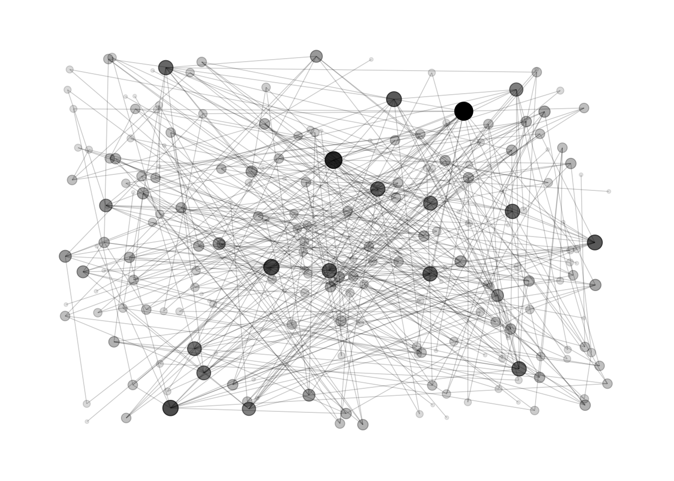

Notes:
https://www.data-to-viz.com/graph/network.html TODO make a better animation for this, you need to find strongly connected omponents

Slide 4

Spark
Giraph
GiraphLab
GraphX

Slide 5

GiraphLab
Spark
Giraph
GraphX

Slide 6
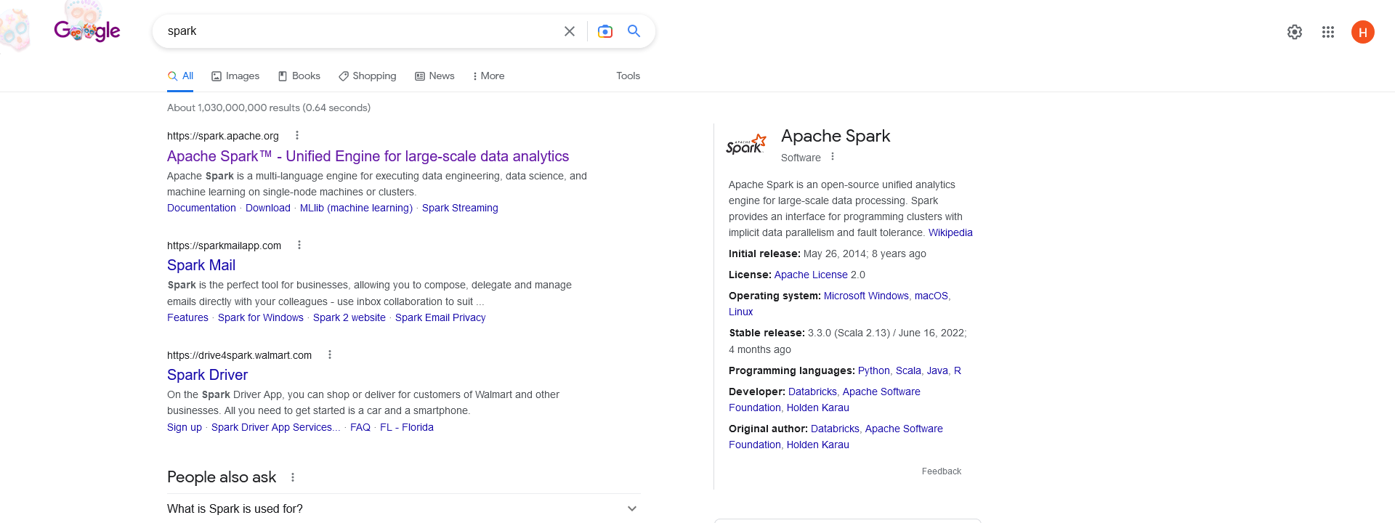
Notes:
Google page

Slide 7
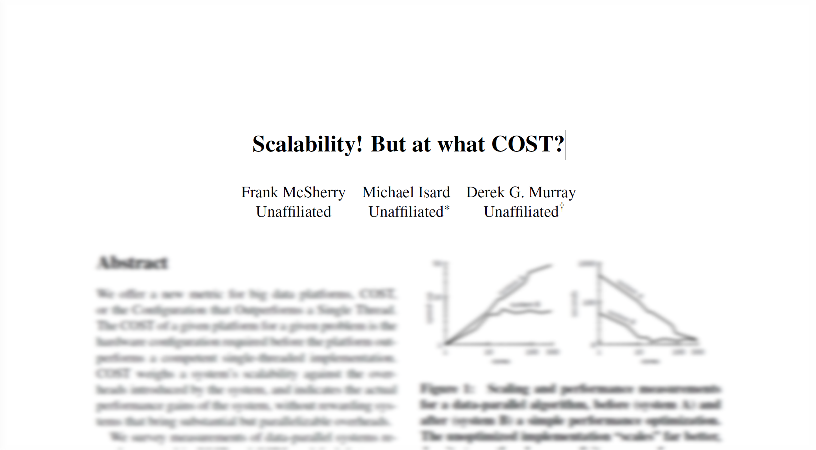
Notes:
http://www.frankmcsherry.org/graph/scalability/cost/2015/01/15/COST.html#

Slide 8

graphs/hr
Spark
4
Giraph
18
GiraphLab
14
GraphX
14
24

Slide 9
“If you are going to use a big data system for yourself, see if it is faster than your laptop.”
- Frank McSherry

Slide 10
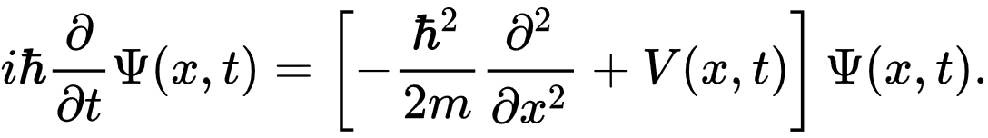
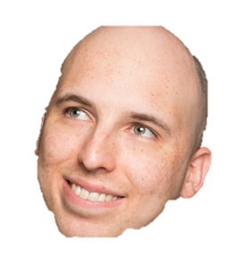
€€€

Slide 12
What We Know We Don't Know
Hillel Wayne
@hillelogram

Slide 13
Topics
Why Empirical Engineering Matters
What it looks like
What it says (or doesn’t say)
How you can get started

Slide 14
www.hillelwayne.com/talks/ese
Notes:
References
Notes
Questions

Slide 15
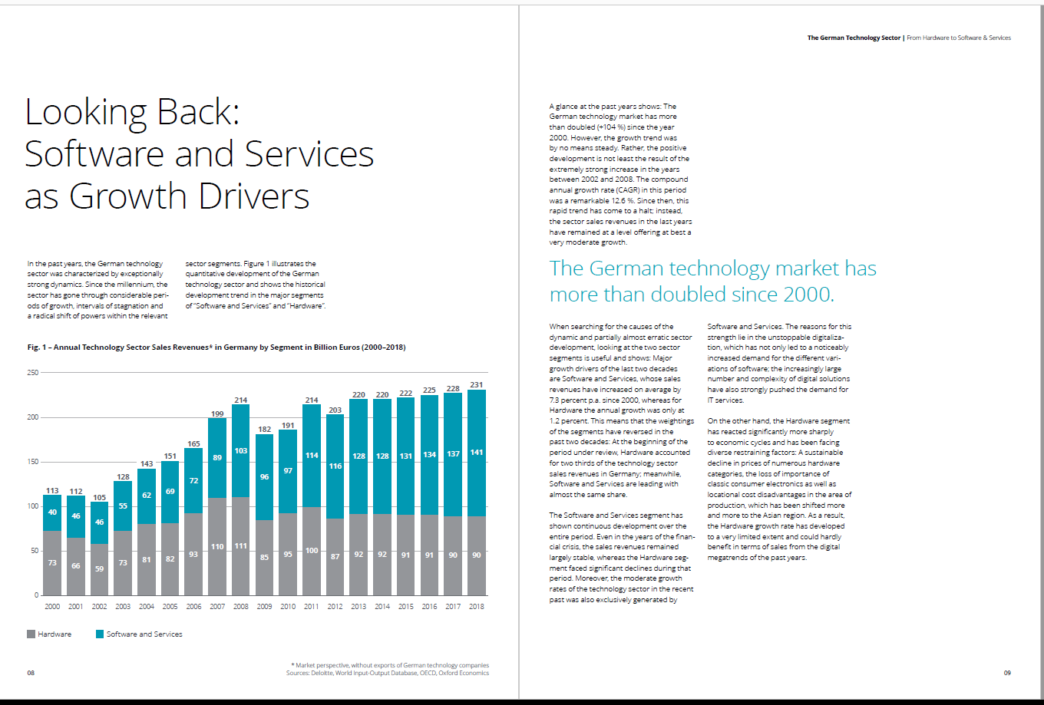
Notes:
Deloitte

Slide 16
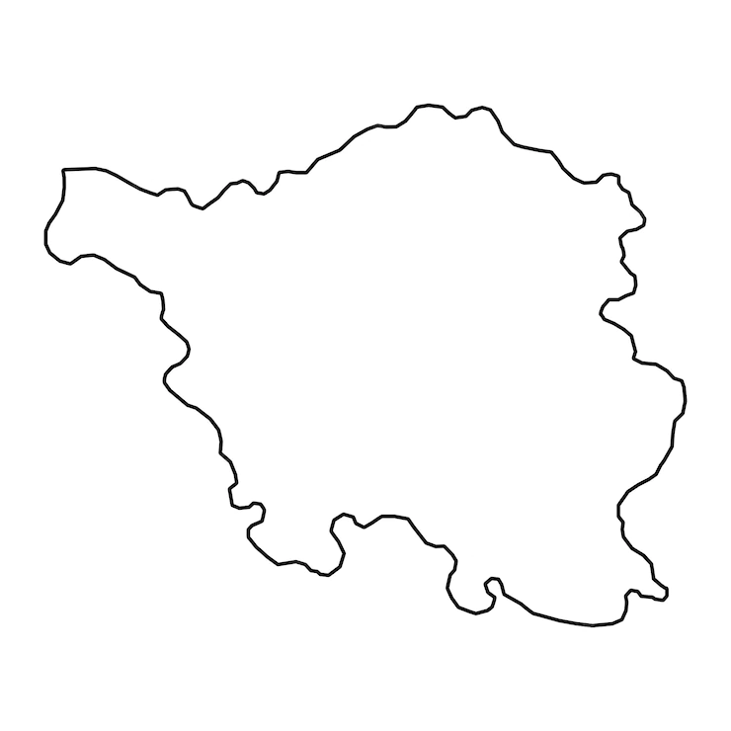

Slide 17


Slide 18
TDD is a discipline for programmers like ... sterile procedure is for surgeons. Are there times when surgeons don’t use sterile procedure?
- Uncle Bob, The Pragmatics of TDD

Slide 19
Test-first fundamentalism is like abstinence-only sex ed: An unrealistic, ineffective morality campaign for self-loathing and shaming.
- David Heinemeier Hansson, TDD is dead. Long Live Testing.

Slide 20
Scientific Method
Observe
Predict
Test
Evaluate
Notes:
TODO animate

Slide 21
"Syntax highlighting is juvenile. […] when I became a man, I did away with childish things."
- Rob Pike

Slide 22
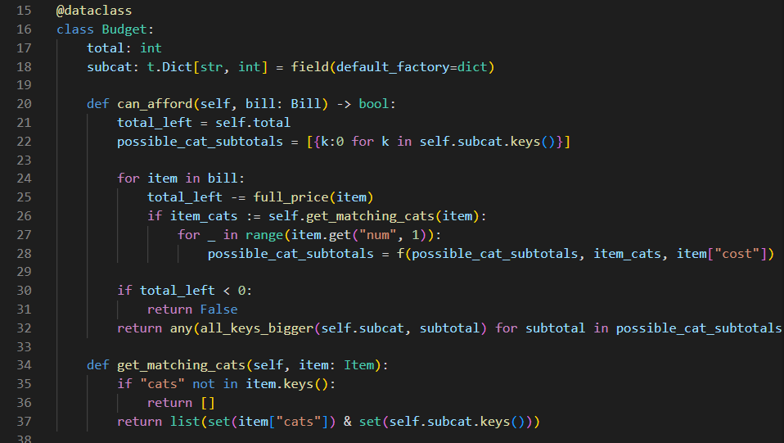
Notes:
Maybe slide after

Slide 23
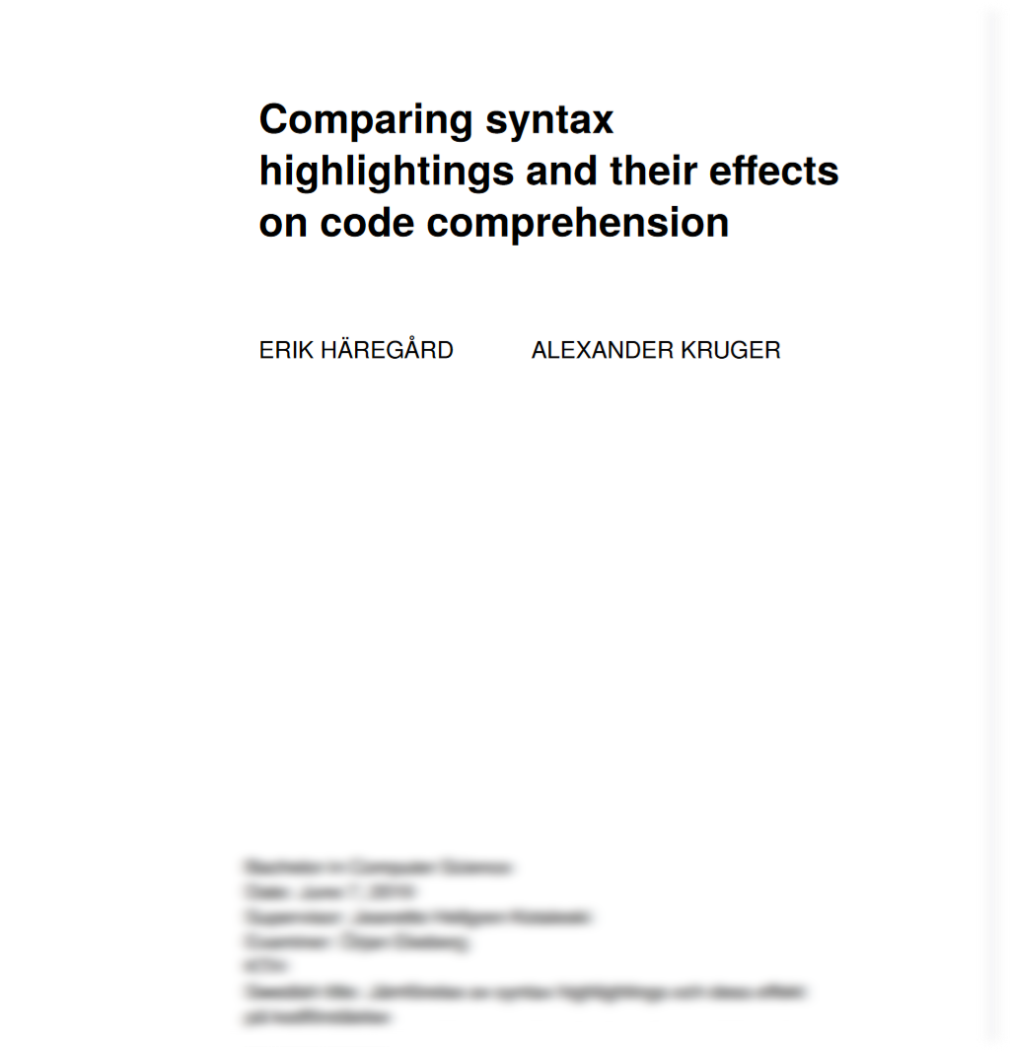

Slide 24
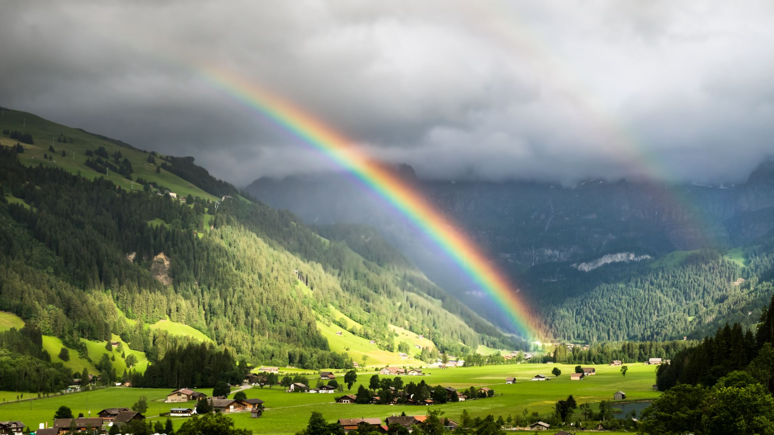
Notes:
Turnoff your colors!

Slide 25
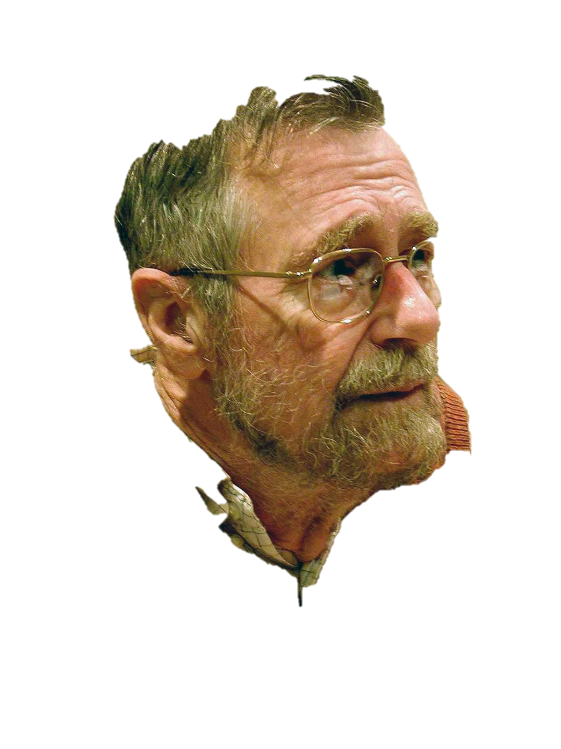

Slide 26
A
B
C
D
A
B
C
D
A
B
C
D

Slide 27
Under 18 years old | 6.52%
18-24 years old | 25.47%
25-34 years old | 39.52%
35-44 years old | 18.42%
45-54 years old | 6.64%
55-64 years old | 2.21%
65 years or older | 0.51%
Prefer not to say | 0.7%
15
65
Notes:
https://insights.stackoverflow.com/survey/2021#demographics-age

Slide 28

Notes:
Undergrads

Slide 29

= ¢¢¢
= €€€
Notes:
10 EUR/hr 200 EUR/hr (or whatever germans are paid)

Slide 30

nah
Notes:
“Animate on ‘is give up’”

Slide 31


Parachute Gag
Notes:
Advance on WHEN
Make PUSH gesture

Slide 32



Parachute?
0
0
Okay?
1
0
0
Notes:
Well, instead of pushing people out of airplanes

Slide 33
Natural Experiment
Notes:
“Usually getting all the data is hard”

Slide 34
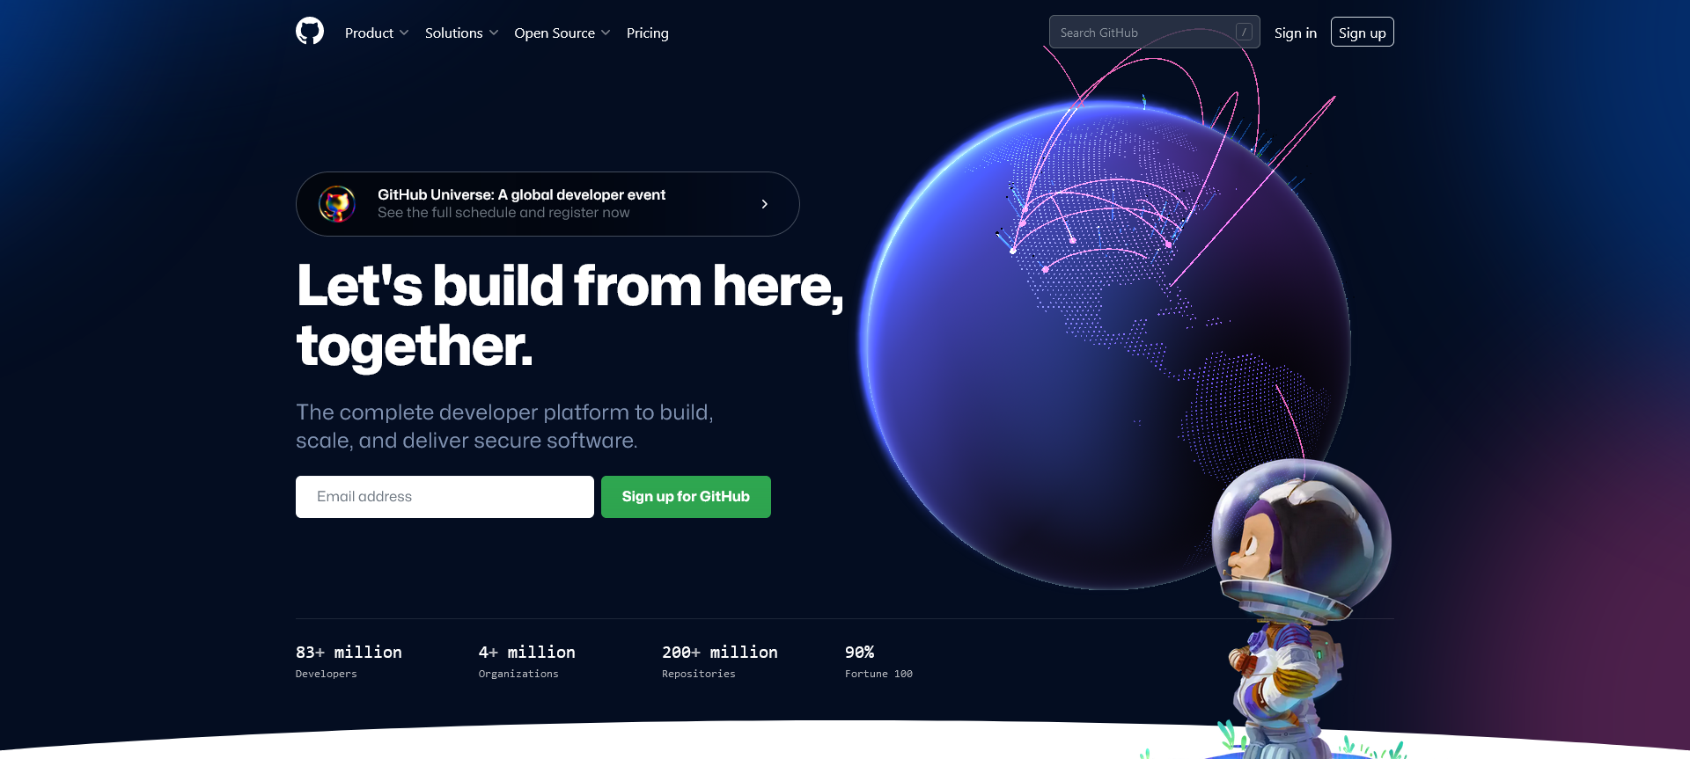

Slide 35

Notes:
https://www.usenix.org/system/files/conference/osdi14/osdi14-paper-yuan.pdf
https://www.eecg.utoronto.ca/failureAnalysis/

Slide 36
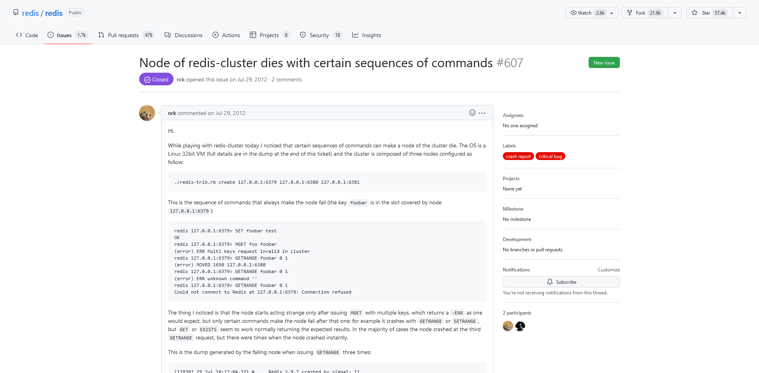
Notes:
https://github.com/redis/redis/issues/607

Slide 37
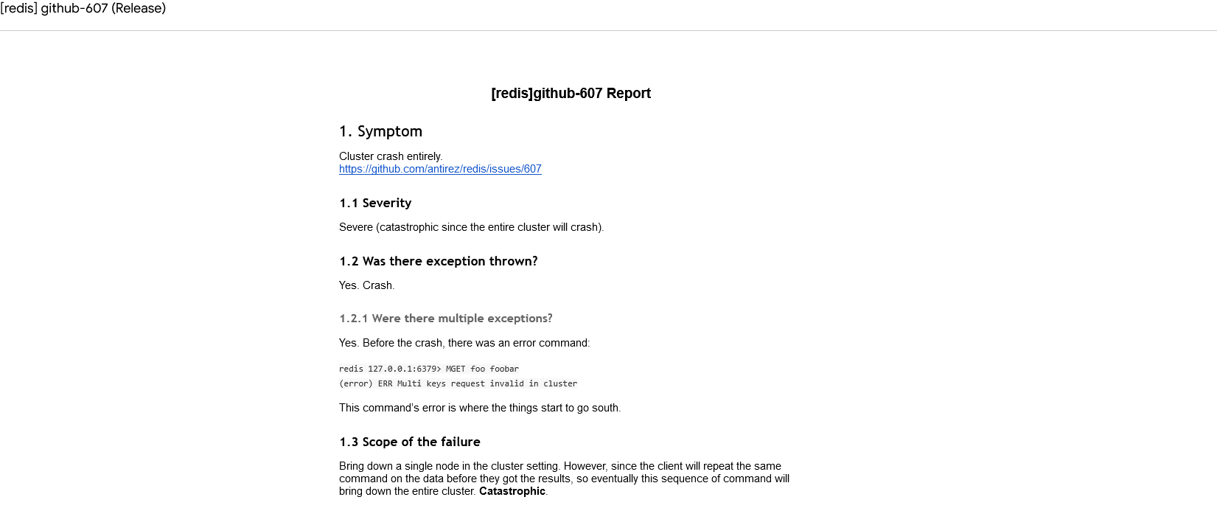
Notes:
https://docs.google.com/document/d/1q0wQkD53J_BHbauPVGtg3pxLdp_1747gQI2Llcxql8s/pub

Slide 38
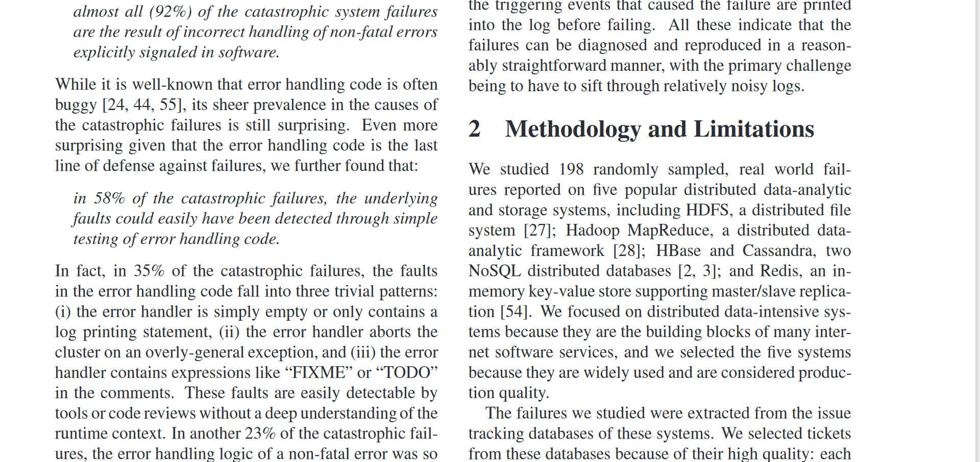

Slide 39


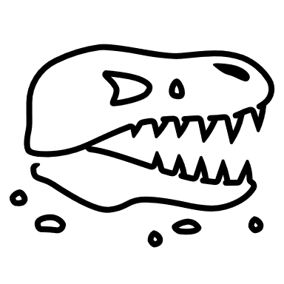
Size
Weight
Carnivore?
Pack animal?
Hot blooded?
Feathers?
Notes:
Dinosaur

Slide 40

Observational Studies
???

Slide 41
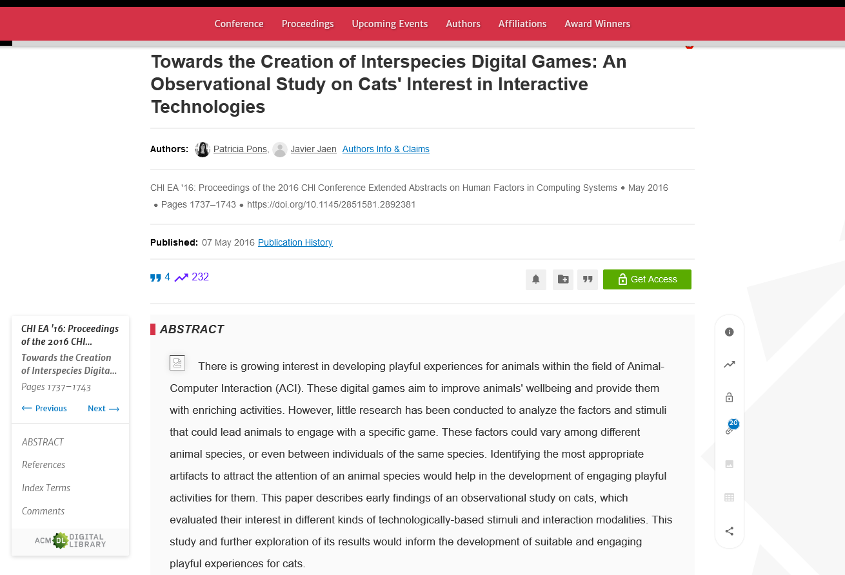
Recurring opinions or productive improvements—what agile teams actually discuss in retrospectives
https://link.springer.com/article/10.1007/s10664-016-9464-2

Slide 42


ubhyhoxqpvxoczglnhjndvzmhglicqmmofeoztzhhpolkiyeqbaiwhvlrprwgkmyapzosvmexvpktqzbdqmhkvmknuqbmvzanfkjlxmfzqqgevygfdhespwqmcttgfhrasdagh

Slide 43
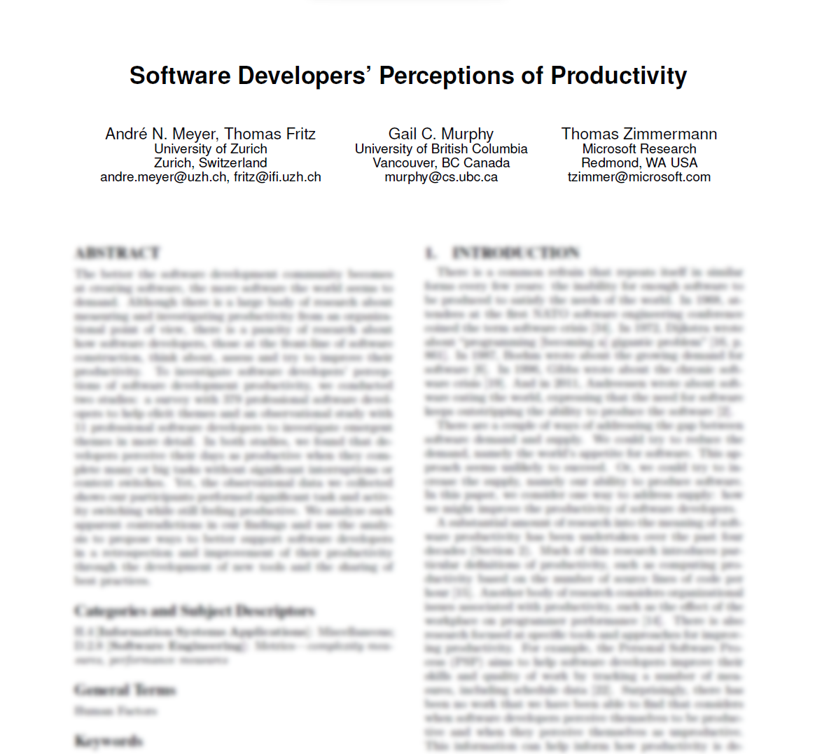

Slide 44


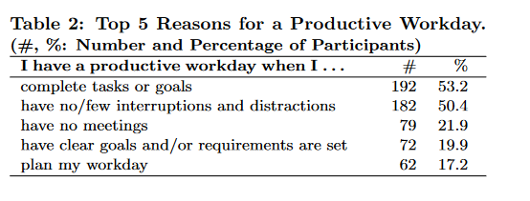
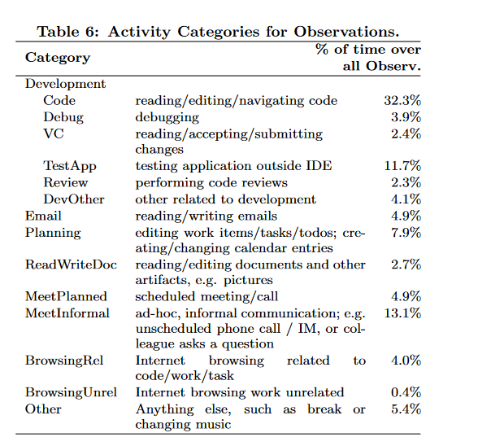
11
379
Notes:
Think it’s based on NUMBER
Meetings are okay if small and well-scoped

Slide 45

Recap

Slide 47

ADVERT
Hire me!
I teach workshops
www.hillelwayne.com/consulting
Past clients: NASA, Netflix, Facebook, CrowdStrike, McKinsey

Slide 48
Intentionally Blank
Notes:
Nothing

Slide 49


Slide 50
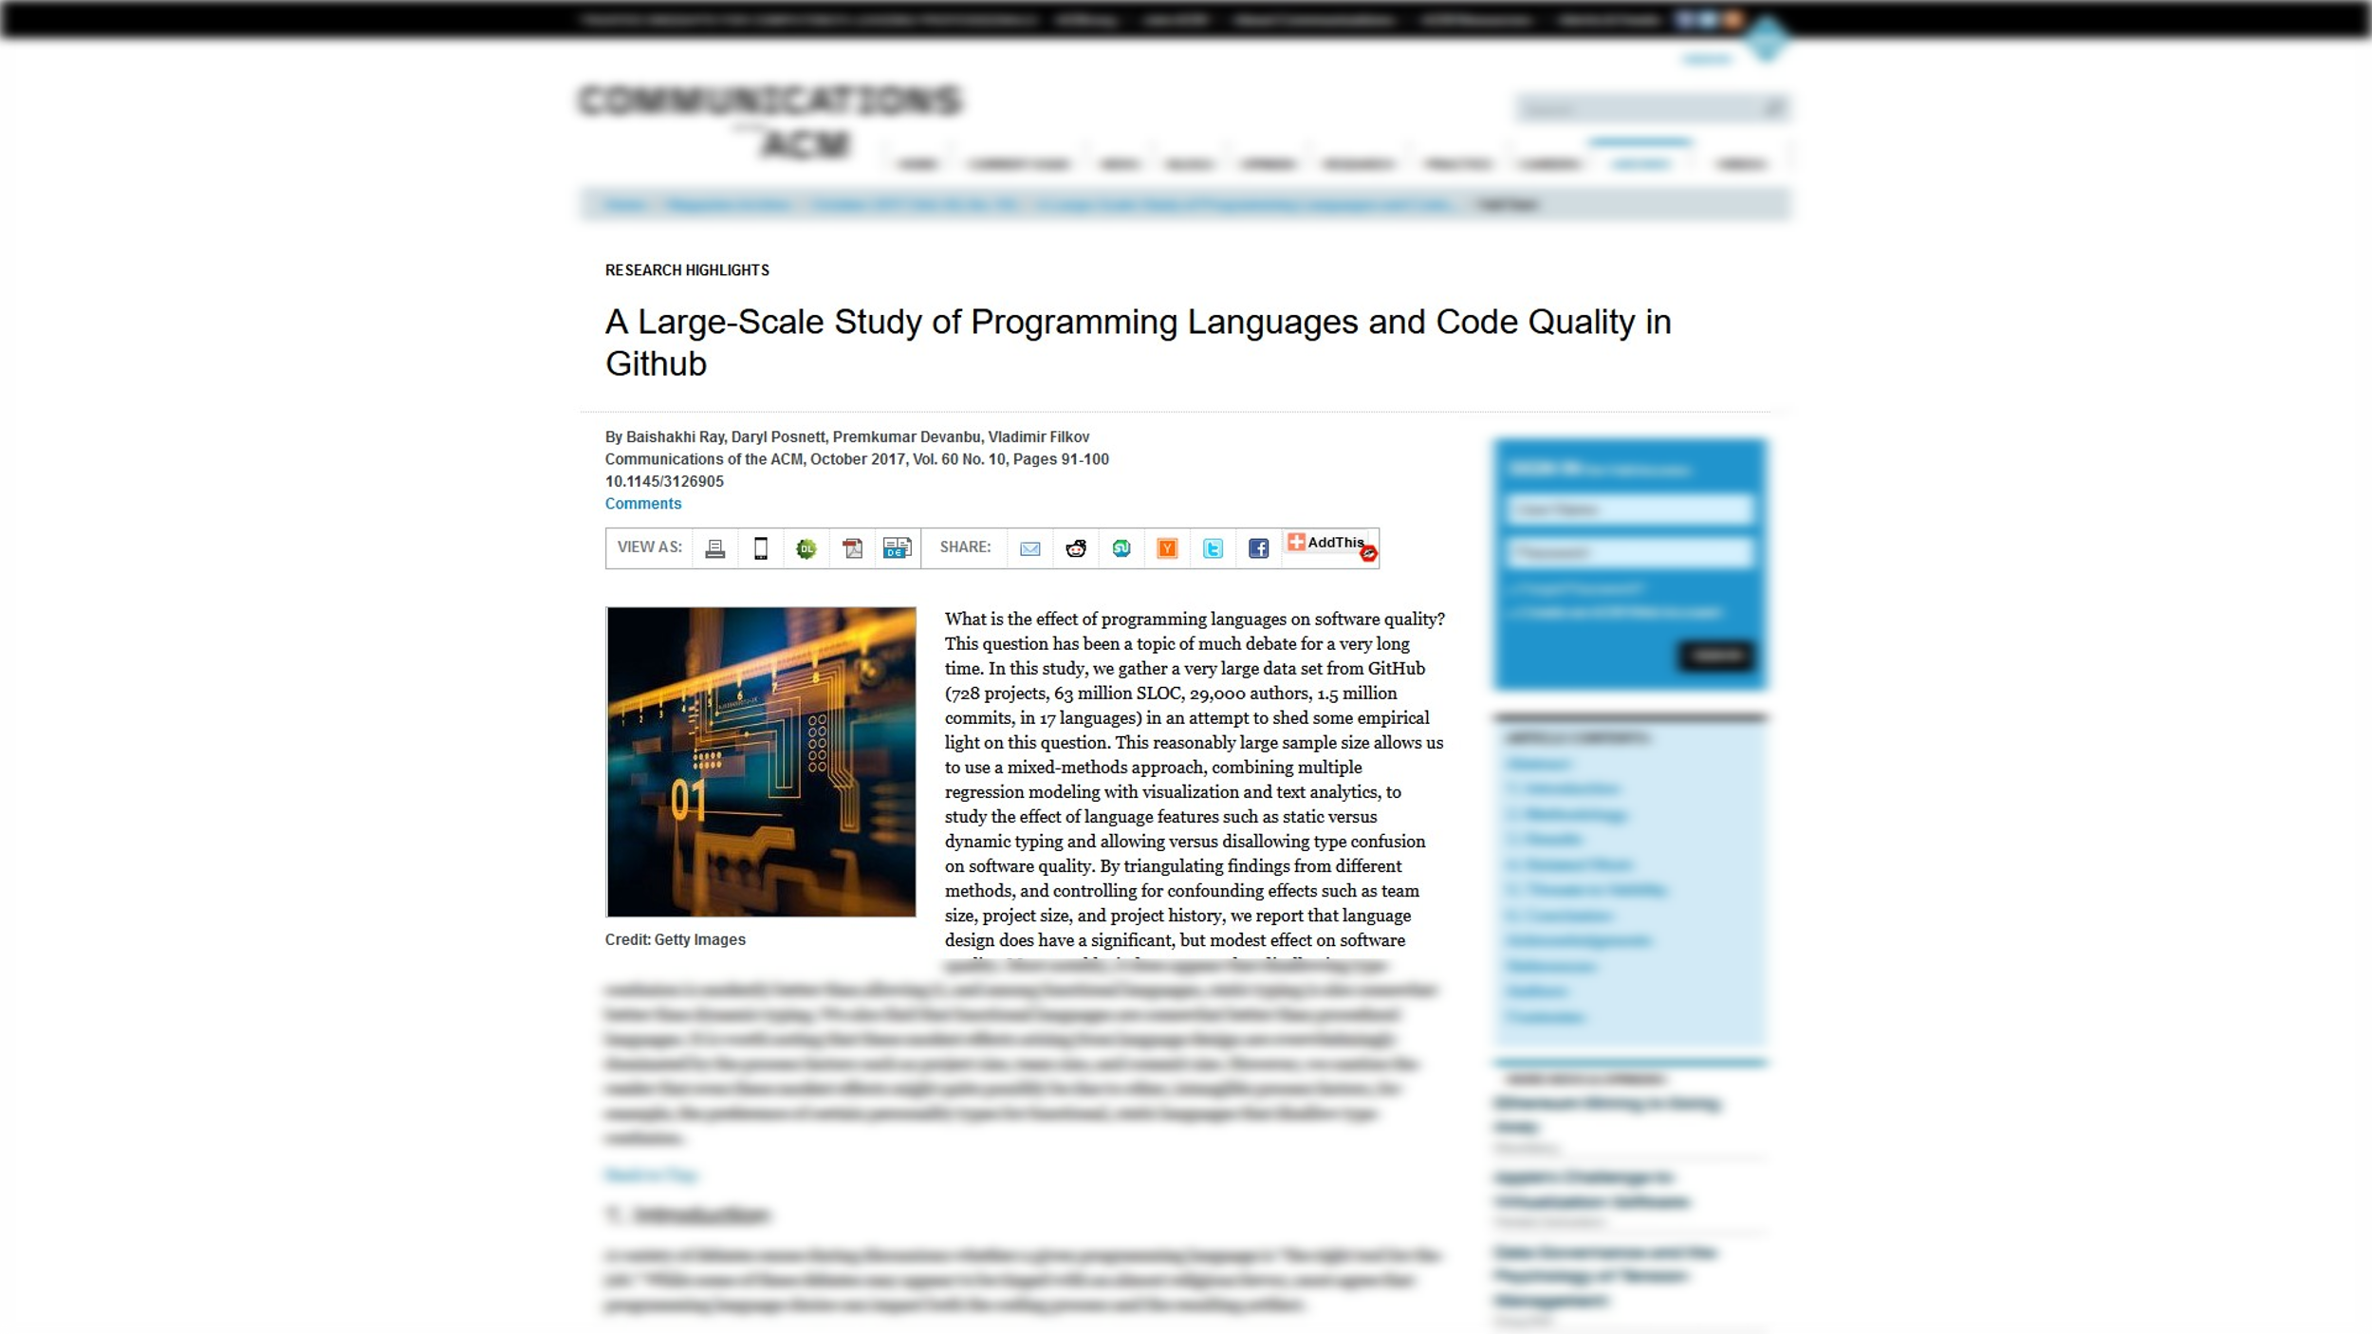

Slide 51
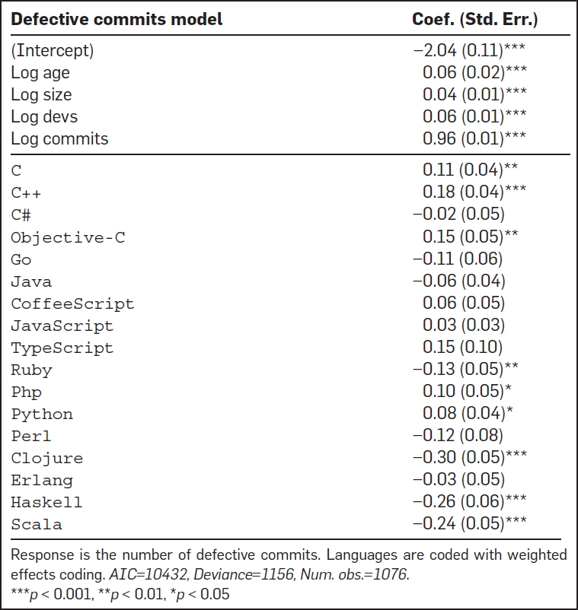
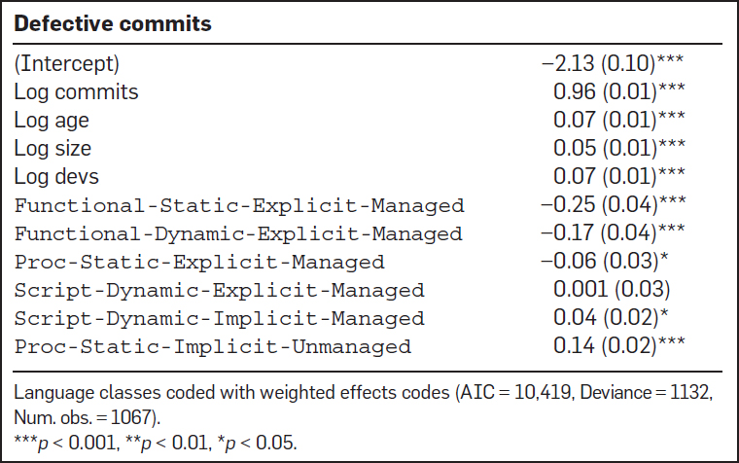

Slide 52
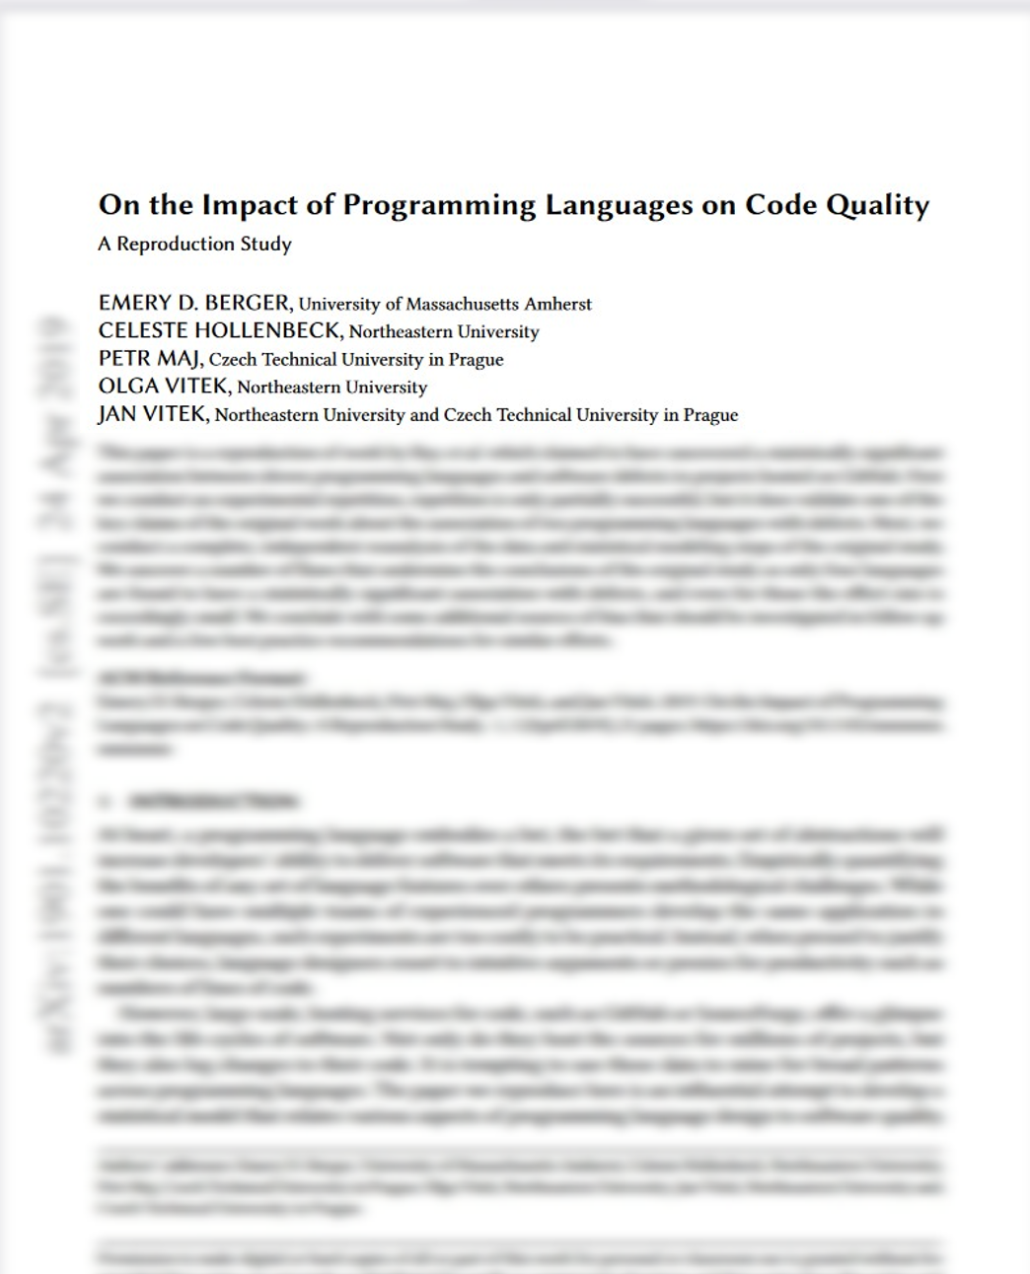

Slide 53
https://www.hillelwayne.com/post/this-is-how-science-happens/

Slide 54

C++ Projects

Slide 55




Slide 56
“Fix typos in docs”
“Add bug reporting instructions”
“Allow fixc [function] to take rands”
“Add lazyness to infix operators”

Slide 57
See website for papers!
Notes:
Code review papers

Slide 58
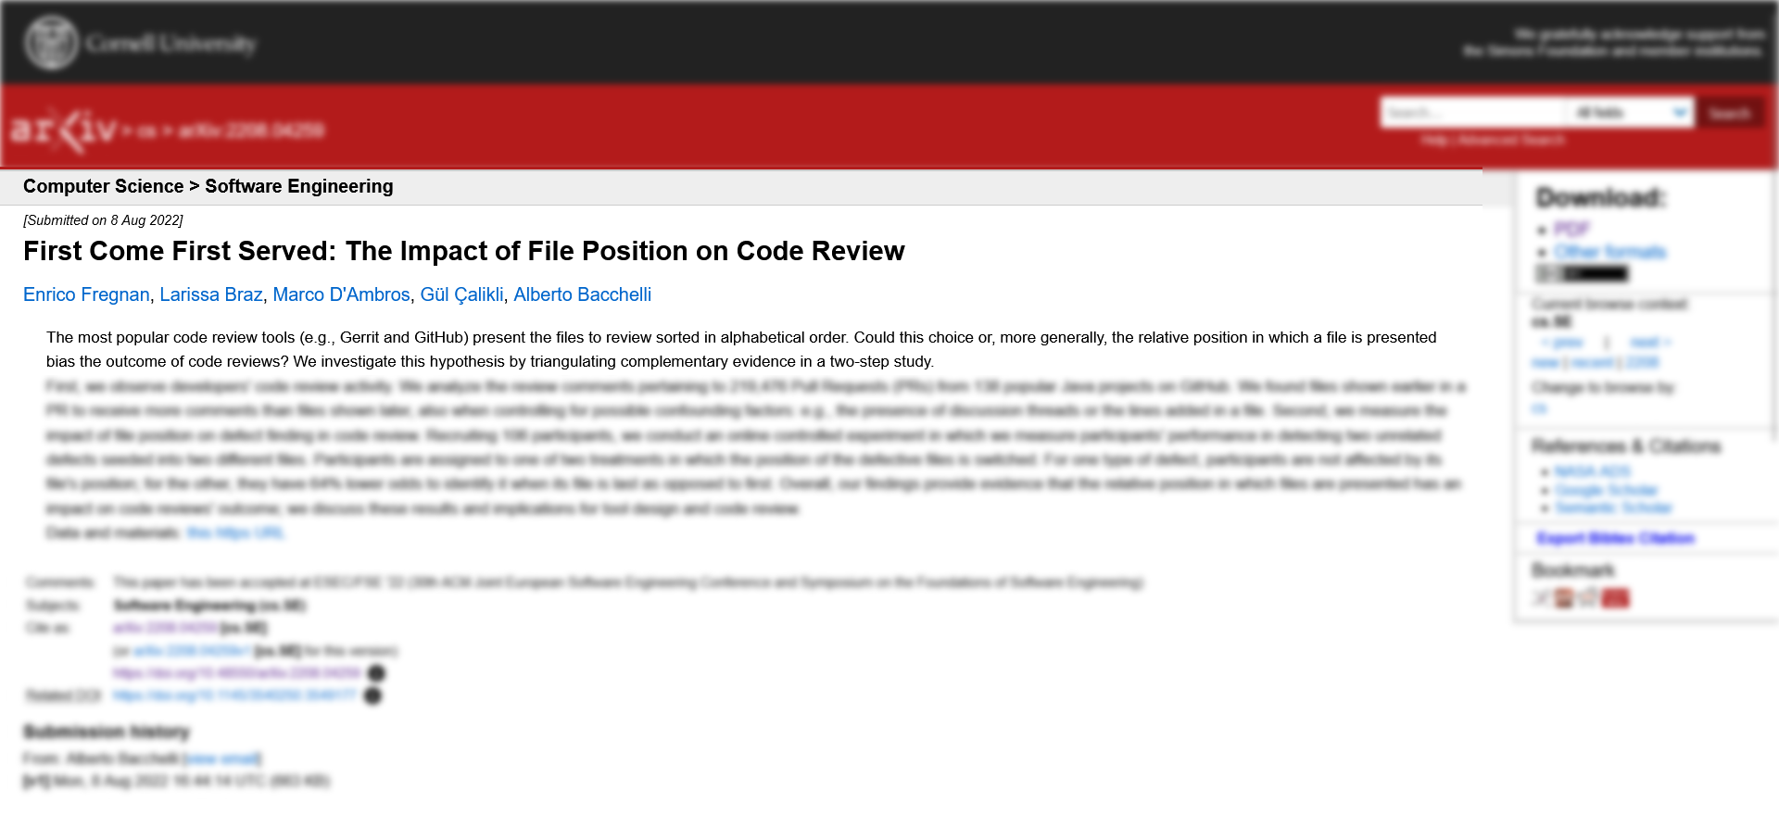

Slide 59




Slide 60
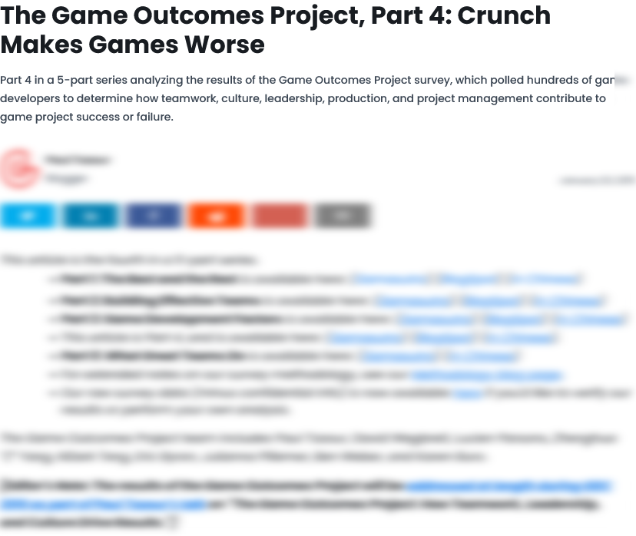
Notes:
https://www.gamedeveloper.com/business/the-game-outcomes-project-part-4-crunch-makes-games-worse
http://intelligenceengine.blogspot.com/2015/01/the-game-outcomes-project-part-5-crunch.html

Slide 61



40
60
80
100

Slide 62
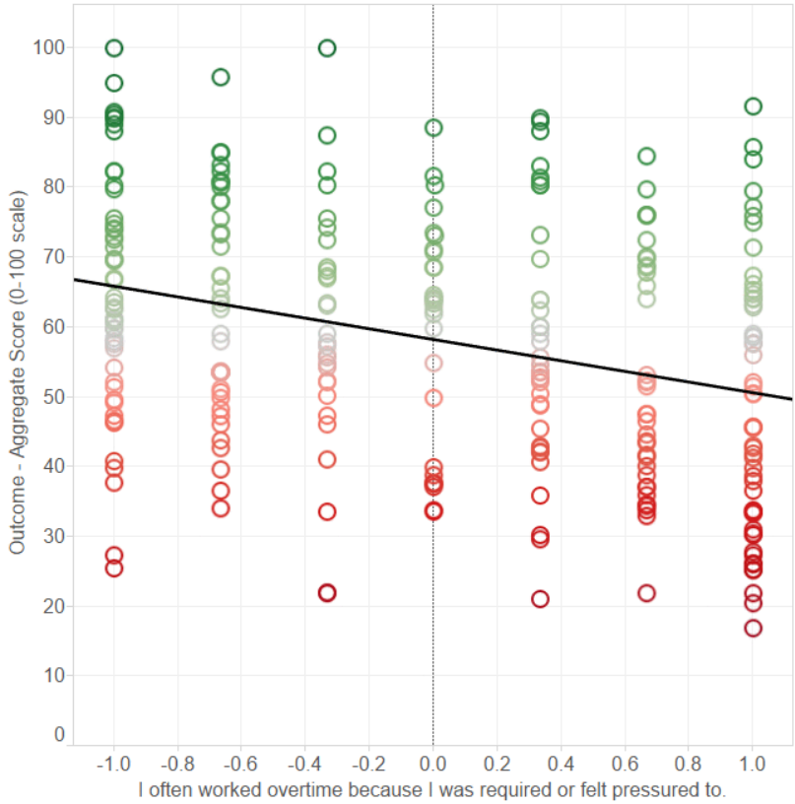

Slide 63
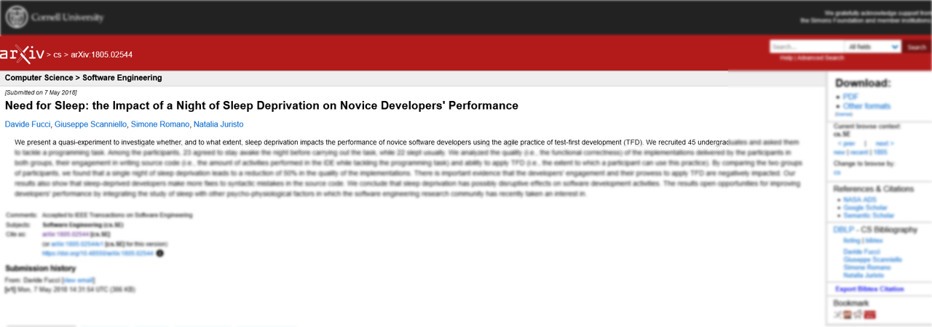

Slide 64
50%

Slide 65
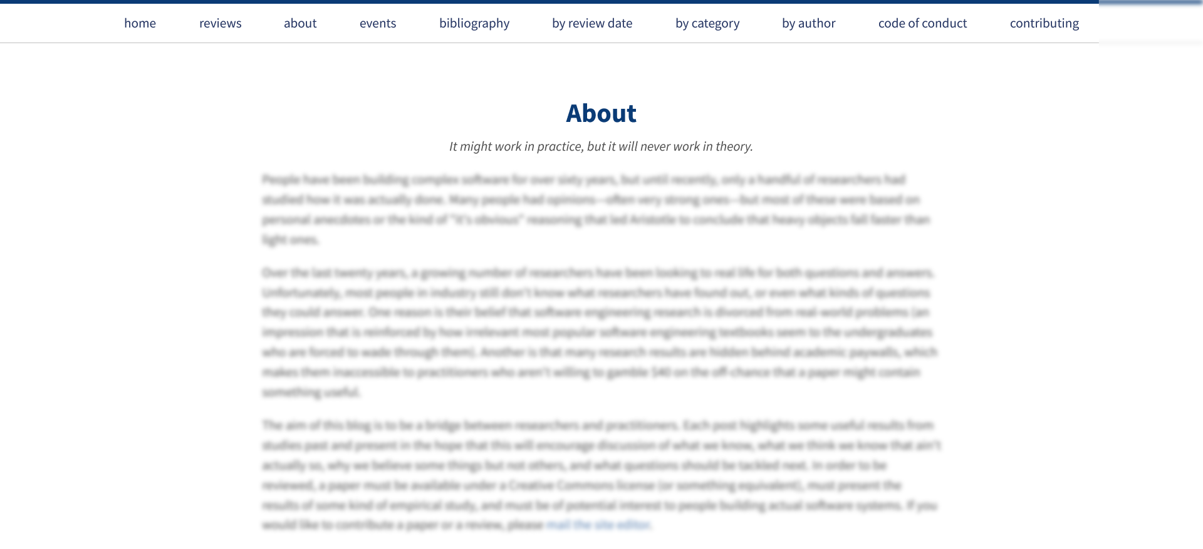

Slide 66
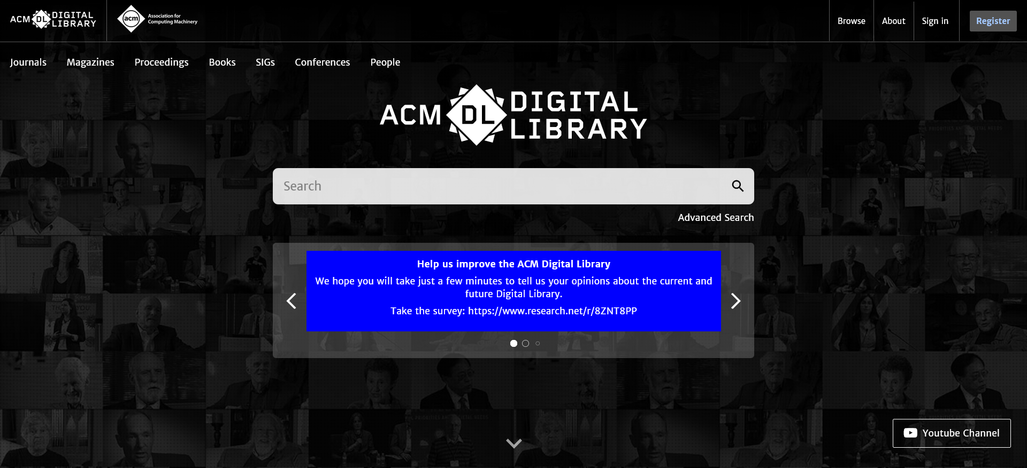

Slide 67
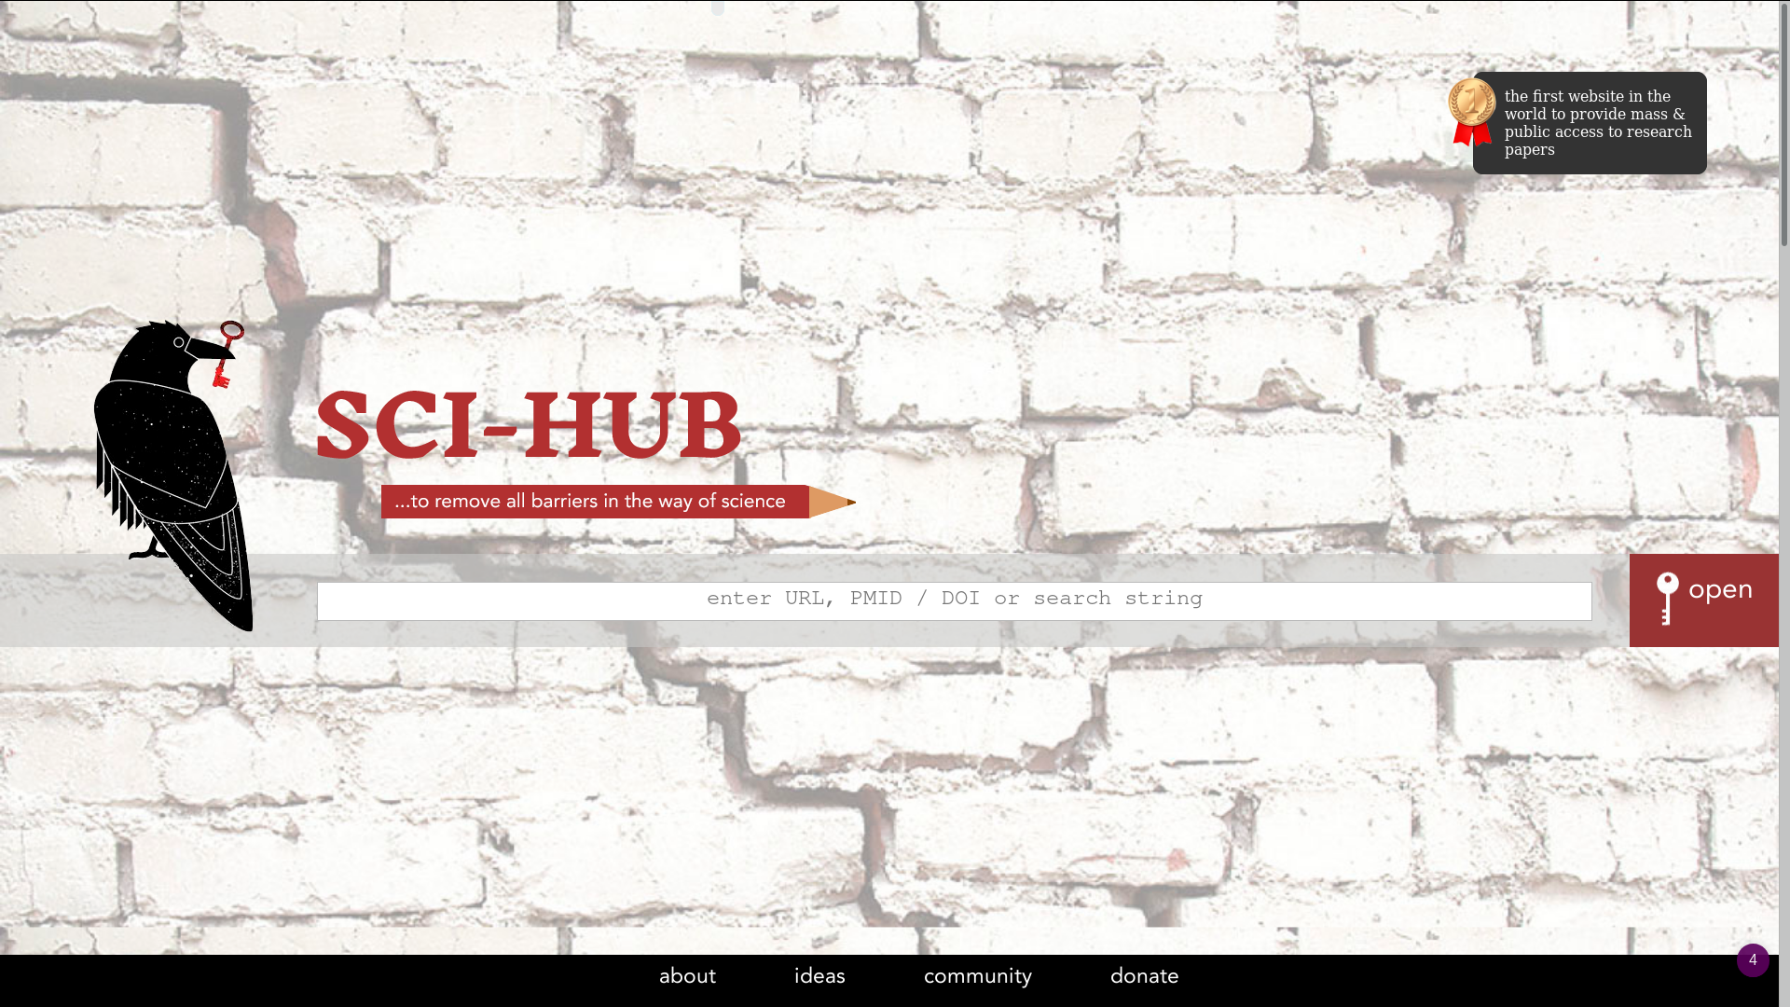

Slide 68
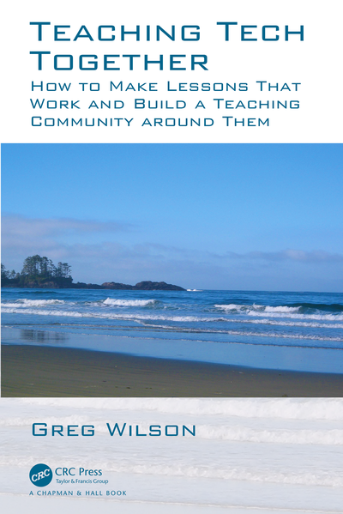
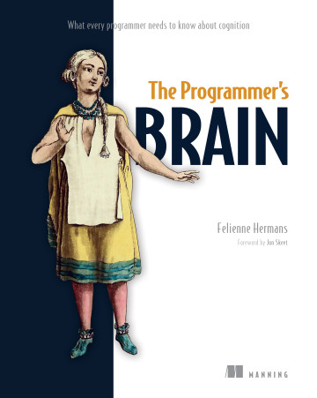

Slide 69
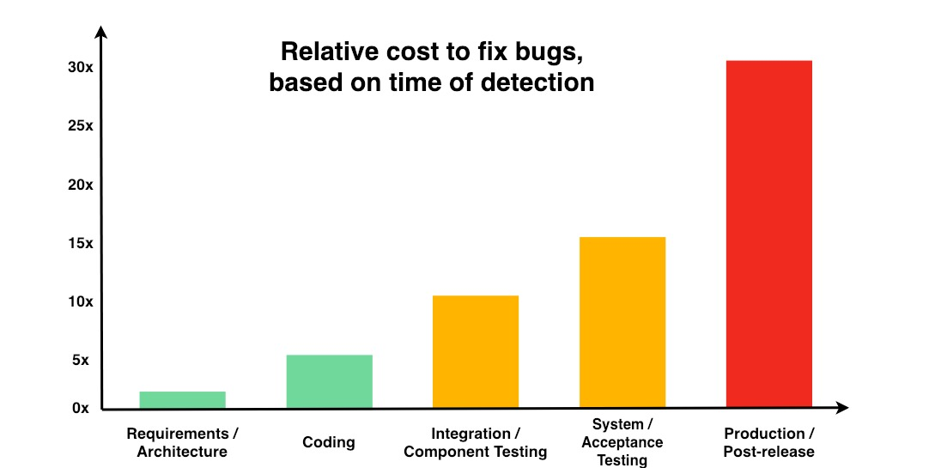

Slide 70
www.hillelwayne.com/talks/ese

Slide 71
Conclusions
Science is hard
We’re not very good at it
Take more naps
Notes:
Science is hard

Slide 72
Thank you!

