Slide 1
How to find resilience bugs in systems that don't exist
Hillel Wayne
Notes:
SLOWER

Slide 2
do_thing (v 0.1)
check_if_thing_marked_done
mark_thing_as_done
actually_do_the_thing
Notes:
Error: mark thing done, then we fail

Slide 3
do_thing (v 0.1)
check_if_thing_marked_done
mark_thing_as_done
actually_do_the_thing || fail
Notes:
Error: mark thing done, then we fail

Slide 4
do_thing (v 0.2)
check_if_thing_marked_done
actually_do_the_thing || fail
mark_thing_as_done
Notes:
We'll even harden it so that `actually_do_the_thing` never fails
New error. What if there are TWO thing doers
(You don't actually need two thing doers)
[[Maybe v0.3, do_thing_and_mark_as_done

Slide 5
do_thing (v 0.2)
check_if_thing_marked_done
actually_do_the_thing
mark_thing_as_done
Notes:
We'll even harden it so that `actually_do_the_thing` never fails
New error. What if there are TWO thing doers
(You don't actually need two thing doers)
[[Maybe v0.3, do_thing_and_mark_as_done

Slide 6
do_thing
do_thing
1
check_if_thing_marked_done
actually_do_the_thing
mark_thing_as_done
3
check_if_thing_marked_done
actually_do_the_thing
mark_thing_as_done
2
4
Notes:
New error. What if there are TWO thing doers

Slide 7
do_thing
send_package
check_if_thing_marked_done
actually_do_the_thing
mark_thing_as_done
check_if_package_sent
tell_warehouse_to_send_package
mark_package_as_sent
Notes:
New error. What if there are TWO thing doers

Slide 8
do_thing
assign_speaker_to_slot
check_if_thing_marked_done
actually_do_the_thing
mark_thing_as_done
check_if_slot_filled
add_to_agenda
mark_slot_filled
Notes:
New error. What if there are TWO thing doers

Slide 9
do_thing
install_app_on_device
check_if_thing_marked_done
actually_do_the_thing
mark_thing_as_done
check_if_app_installed
send_install_cmd_to_device
mark_as_installed
Notes:
Doesn't seem as bad except the case I'm thinking of this would randomly delete data

Slide 10
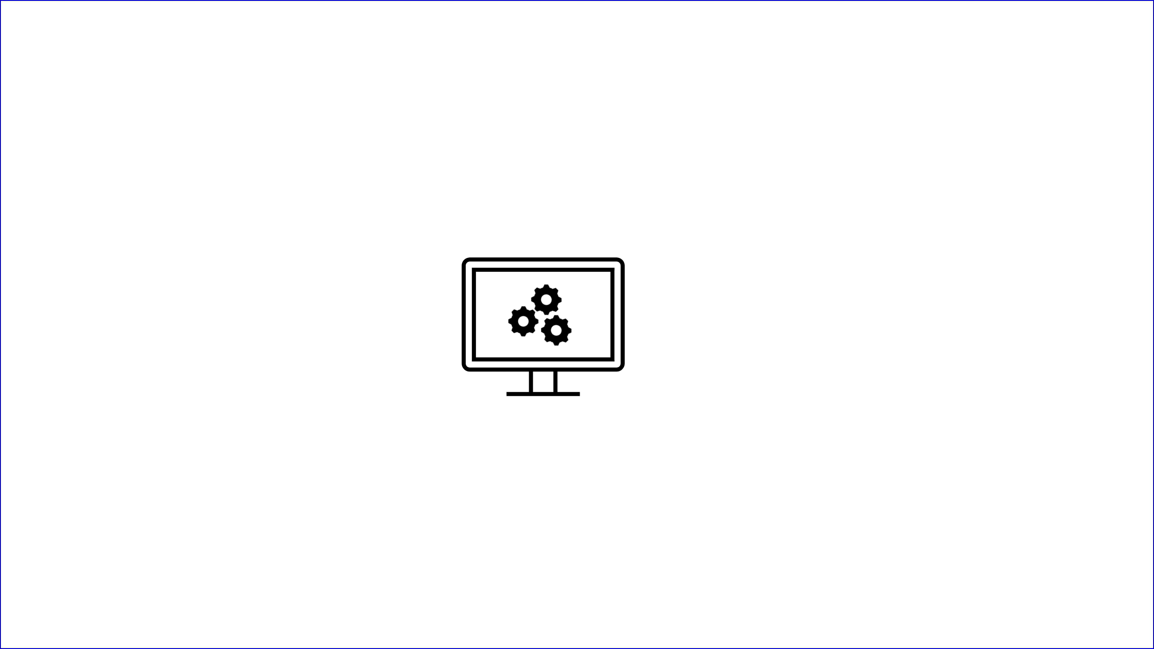

Slide 11
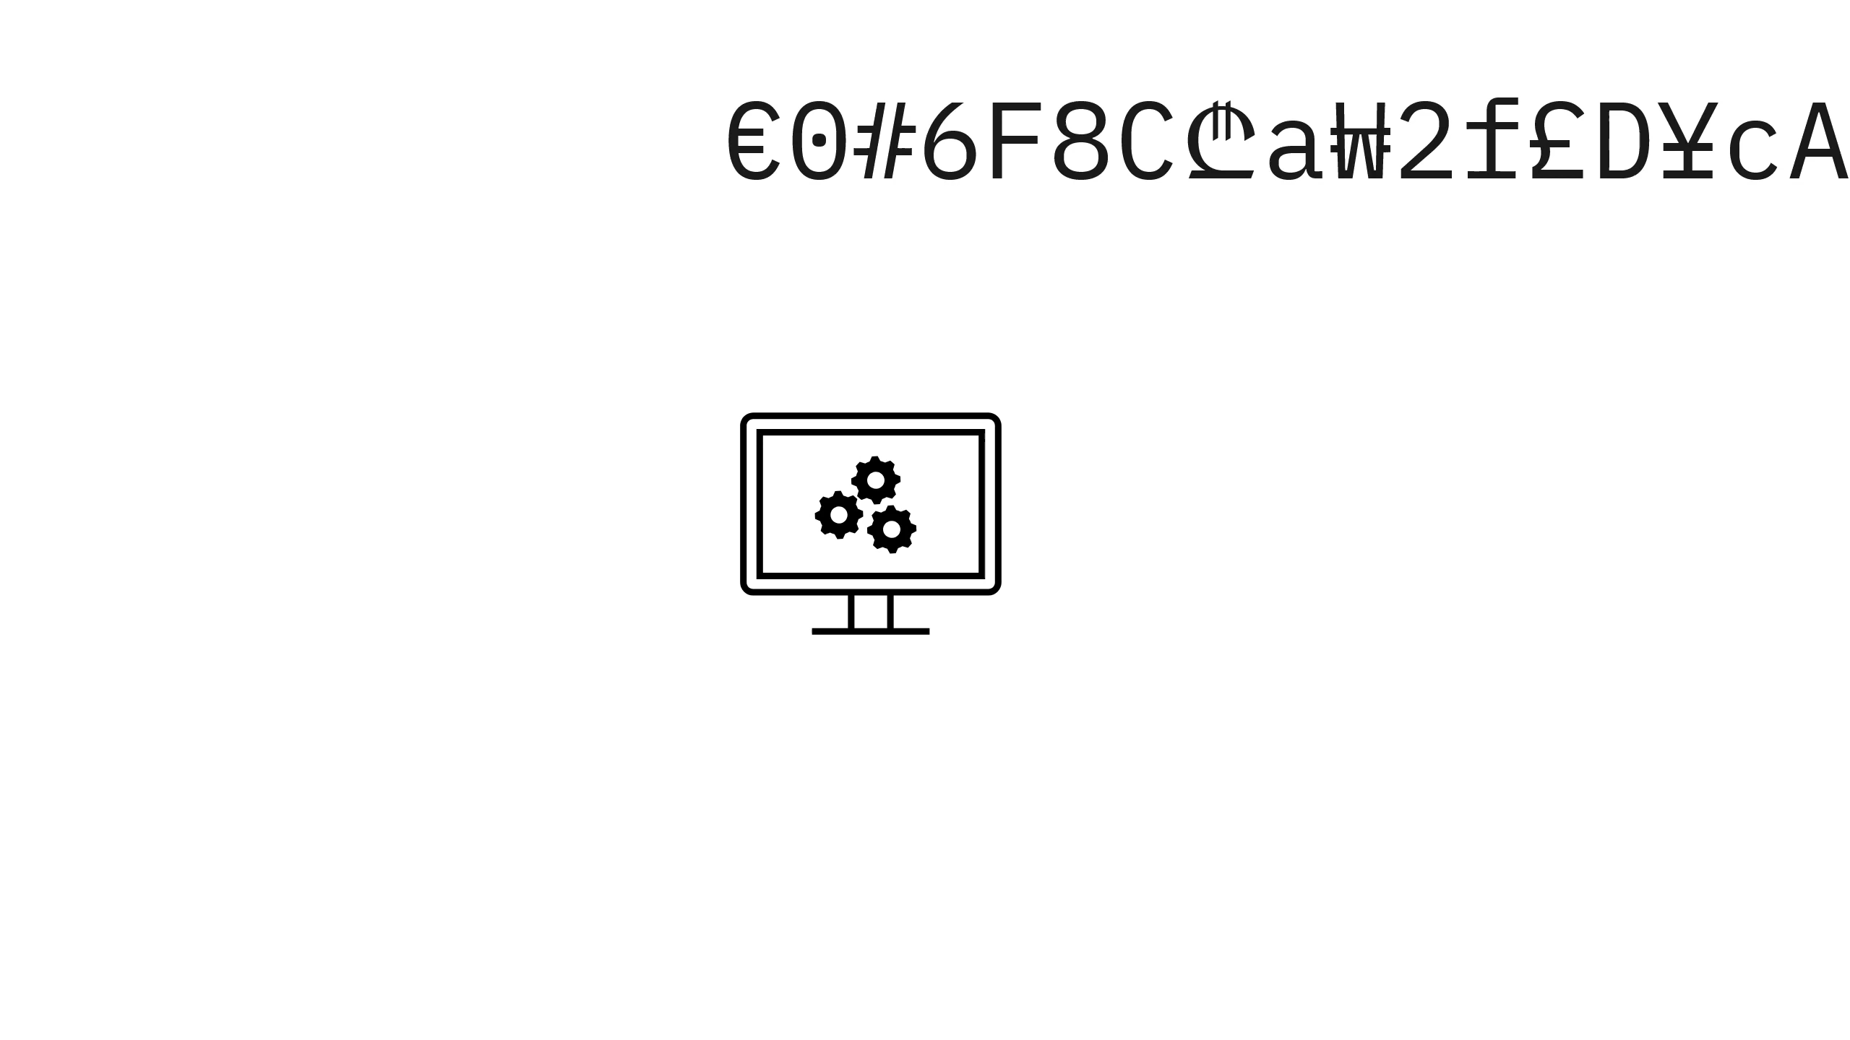

Slide 12
Formal methods
Tools and languages that do this
We are not covering them
We are covering the perspectives of formal methods
Notes:
We do this implicitly, Formal Specifications is about making how this is done explicit. It’ hard, so we’re not covering it, instead we cover the things that it helps teach us.

Slide 13
Topic Outline
Properties
Verification
Environments

Slide 14
Topic Outline
Properties: What it means for systems to be "correct"
Verification: How we can verify correctness
Environment: What we need to make correctness possible

Slide 15
www.hillelwayne.com/talks/qcon26

Slide 16
Property
Something that should be true of the system.
"We have %99.999 uptime"
All messages follow their schemas
assert max([1,2,3]) == 3
" We don't do the thing more than once" (safety)
" We do the thing at least once " (liveness)
Notes:
If not true, we have to change the system.
5 nines of uptime: 5 minutes a year
[Lead] We care about properties insofar as they are verifiable. Most are not verifiable. Some are.

Slide 17
2 QPS
10,000 QPS
10,000 QPS => 2 QPS
(implication)

Slide 18
P => Q
No memory errors => No use-after-free errors
Exactly Once Delivery => At Least Once Delivery
GDPR compliance => cookie banners!

Slide 19
Some properties are stronger than others.

Slide 20
test user_login
test show_items
test add_item
"the user buys something with a coupon"
=>
test enter_checkout
test apply_coupon
test add_shipping
test complete_order

Slide 21
2 QPS
10,000 QPS
1
2
3
!(2 QPS) => !(10,000 QPS)
(contrapositive)

Slide 22
test user_login
test show_items
test add_item
"the user buys something with a coupon"
<=
test enter_checkout
test apply_coupon
test add_shipping
test complete_order
Notes:
[[Think about copy]]

Slide 23
Strong properties show that a system is correct.
Weak properties show why a system is incorrect.
Notes:
We see an emphasis on having more weak tests than strong tests in every testing culture
For example, Agile has the test pyramid
"No alarms" vs lots of alarms
[[Abstract is weaker than the implementation!]]

Slide 24
Back to the thing doer
check_if_thing_marked_done
mark_thing_as_done
actually_do_the_thing || fail
check_if_thing_marked_done
actually_do_the_thing || fail
mark_thing_as_done
We don't do thing more than once
We do thing at least once
Notes:
[lead] Specification tooling has different ways of checking these properties against these sytems, we're going to hand implement the simplest one, brute force model checking

Slide 25
PARAM NumProcs
Check =
⋁ –marked ⋀ step' = "Do"
⋁ marked ⋀ step' = "Done"
Do =
⋀ step = "Do"
⋀ ⋁ ⋀ done' = @ + 1
⋀ step' = "Mark"
⋁ step' = "Check"
Mark =
⋀ marked' = TRUE;
⋀ step' = "Done"
Safety ≅ □(done < 2)
Liveness ≅ ◇(done > 0)
This is boring
Probably hide this

Slide 26


step: {check, mark, do, done}
marked: Boolean
#done: Int
Entirely in our control
Limited control
Notes:
[[Systems failed when world was assumed to be machine]]
Datetiem, record, file
We can mark a package as unset, but we can never unsend the oackage.

Slide 27
check_if_thing_marked_done
mark_thing_as_done
actually_do_the_thing || fail
We don't do thing more than once
We do thing at least once
step: "check"
marked: false
#done: 0
"mark"
false
0
"do"
true
0
"done"
true
1
"check"
true
0
"done"
true
0
"check"
true
1
Notes:
Mention state space, path
[Don't care why fail]
Then mention safety property (next slide is new text)

Slide 28
check_if_thing_marked_done
mark_thing_as_done
actually_do_the_thing || fail
always (#done < 2)
We do thing at least once
step: "check"
marked: false
#done: 0
"mark"
false
0
"do"
true
0
"done"
true
1
"check"
true
0
"done"
true
0
"check"
true
1
Notes:
Safety property, invariant

Slide 29
check_if_thing_marked_done
mark_thing_as_done
actually_do_the_thing || fail
always (#done < 2)
eventually (#done > 0)
step: "check"
marked: false
#done: 0
"mark"
false
0
"do"
true
0
"done"
true
1
"check"
true
0
"done"
true
0
"check"
true
1
Notes:
Liveness property fails
COUNTEREXAMPLE?

Slide 30
check_if_thing_marked_done
actually_do_the_thing || fail
mark_thing_as_done
always (#done < 2)
eventually (#done > 0)
step: "check"
marked: false
#done: 0
"mark"
false
0
"do"
true
0
"done"
true
1
"check"
true
0
"done"
true
0
"check"
true
1
Notes:
Liveness property fails
COUNTEREXAMPLE?

Slide 31
check_if_thing_marked_done
actually_do_the_thing || fail
mark_thing_as_done
always (#done < 2)
eventually (#done > 0)
step: "check"
marked: false
#done: 0
"do"
false
0
"mark"
false
1
"done"
true
1
"check"
true
1

Slide 32
2x
check_if_thing_marked_done
actually_do_the_thing
mark_thing_as_done
always (#done < 2)
eventually (#done > 0)
step: [c, c]
marked: false
#done: 0
[do, check]
false
0
mark, check
false
1
[done, check]
false
1
[check, do]
false
0
[do, do]
false
0
[mark, do]
false
1
[mark, mark]
false
2
Notes:
How do we represent concurrency?
Local State & global state

Slide 33
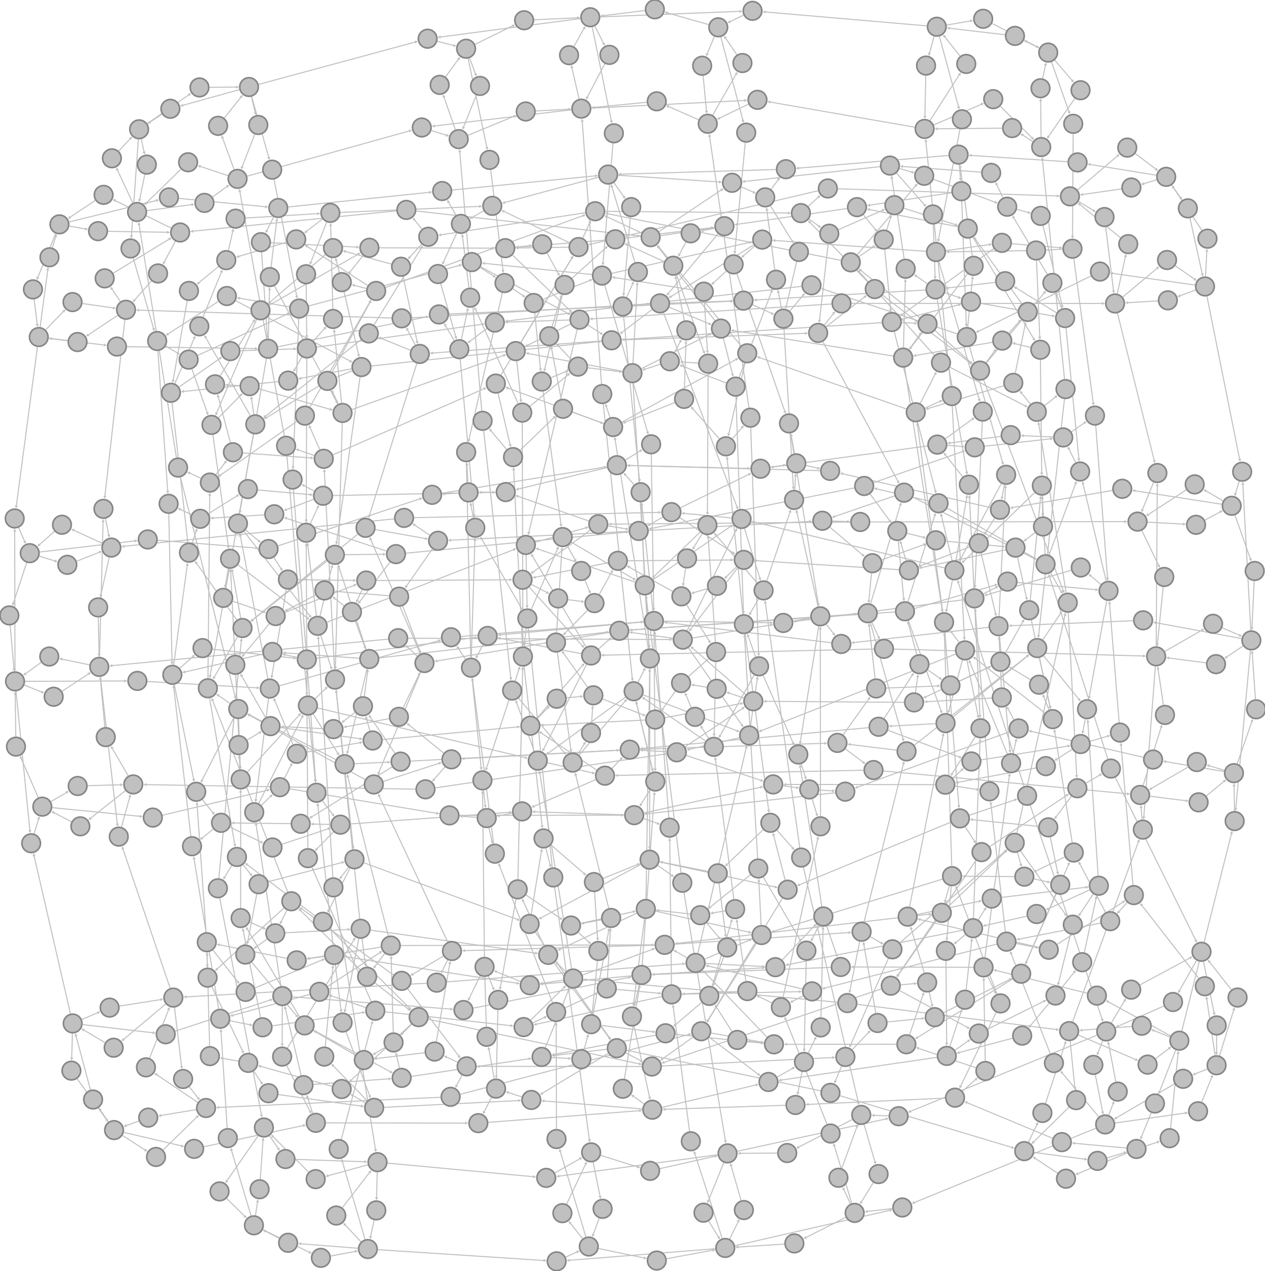
Notes:
x

Slide 34


Slide 35
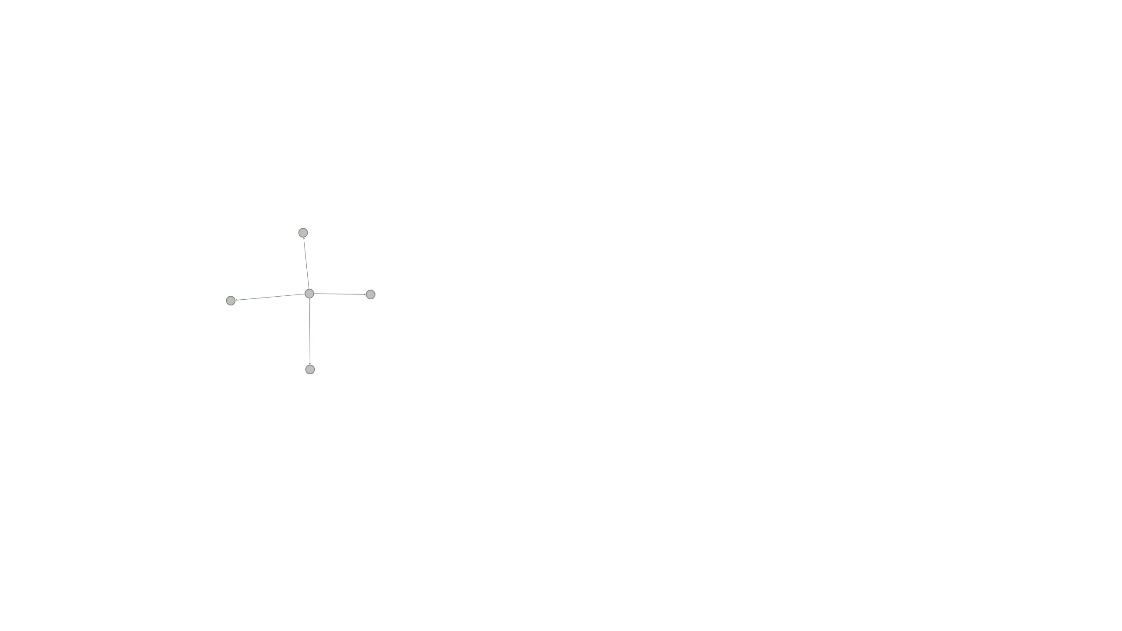
Notes:
Possible for states to go back to old ones

Slide 36
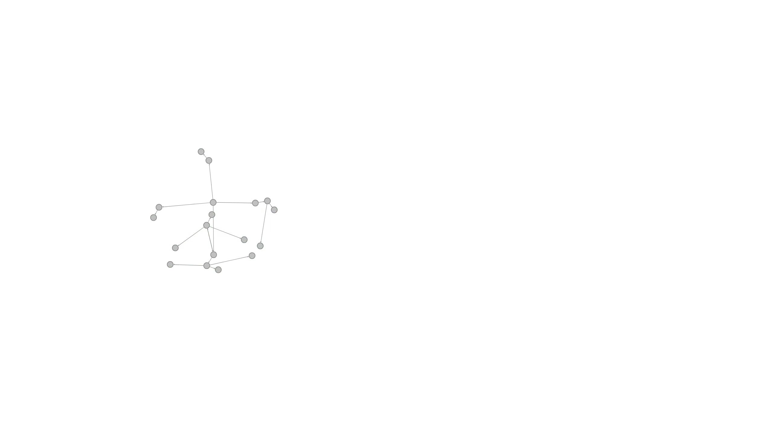

Slide 37
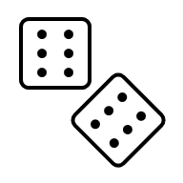




Adversarial Nondeterminism

Slide 38
check_if_thing_marked_done
actually_do_the_thing || fail
mark_thing_as_done
always (#done < 2)
eventually (#done > 0)
"check"
false
0
"do"
false
0
"mark"
false
1
"done"
true
1
"check"
true
1
Notes:
fairness (moved to later)

Slide 39

check_if_thing_marked_done
actually_do_the_thing
mark_thing_as_done
always (#done < 2)
eventually (#done > 0)
"check"
false
0
"do"
false
0
"mark"
false
1
"done"
true
1
"check"
true
1

Slide 40
Environment

Slide 41
Assumption: what must be true for our system to work.
Notes:
FM really seriously treats the subject of assumptions

Slide 42
check_if_marked_done
mark_as_done
do_thing
V1
Assumptions
always (#done < 2)
eventually (#done > 0)
System never crashes
Notes:
Possible alternate for the assumptions

Slide 43
Assumptions are outside our control.
Our assumptions come from someone else's system, and vice versa.

Slide 44
check_if_marked_done
mark_as_done
do_thing
V1
Assumptions
always (#done < 2)
eventually (#done > 0)
System never crashes
Notes:
Possible alternate for the assumptions

Slide 45
check_if_marked_done
mark_as_done
do_thing || fail
V1
Assumptions
always (#done < 2)
eventually (#done > 0)
System never crashes
do_thing never fails
Notes:
Possible alternate for the assumptions

Slide 46
check_if_marked_done
do_thing || fail
mark_done
V2
Assumptions
always (#done < 2)
eventually (#done > 0)
System never crashes
do_thing fails only finite times

Slide 47
Some assumptions are stronger than others
Stronger | Weaker
No Failures | Finite Failures
Strong Consistency | Eventual Consistency
One writer | Many writers
Weaker assumptions can be compensated by system design

Slide 48
check_if_marked_done
do_thing || fail
mark_done
V2
Assumptions
always (#done < 2)
eventually (#done > 0)
Only one thing doer
System never crashes
do_thing fails only finite times
Notes:
[[Idea for this, there might be a root system that compensates for both]]

Slide 49
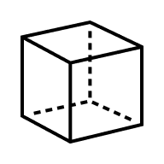
Property
Assumption
Sophistication
Notes:
[[This should be an animation]]
Dead letter queue
NASA Engineering is way more engineering
Espark offline 4 PM New York Time

Slide 50
Weakening an assumption weakens your properties
Notes:
Most often we find bugs from this.
Example: vendor losing eventual consistency for us

Slide 51
Summary
Systems have assumptions and properties
Some properties/assumptions are stronger than others
Strong properties show correctness, weak properties show incorrectness
Simplified models show real-world bugs
Beware the gremlin

Slide 52
Summary
We can learn useful things from mathematical approaches

Slide 53
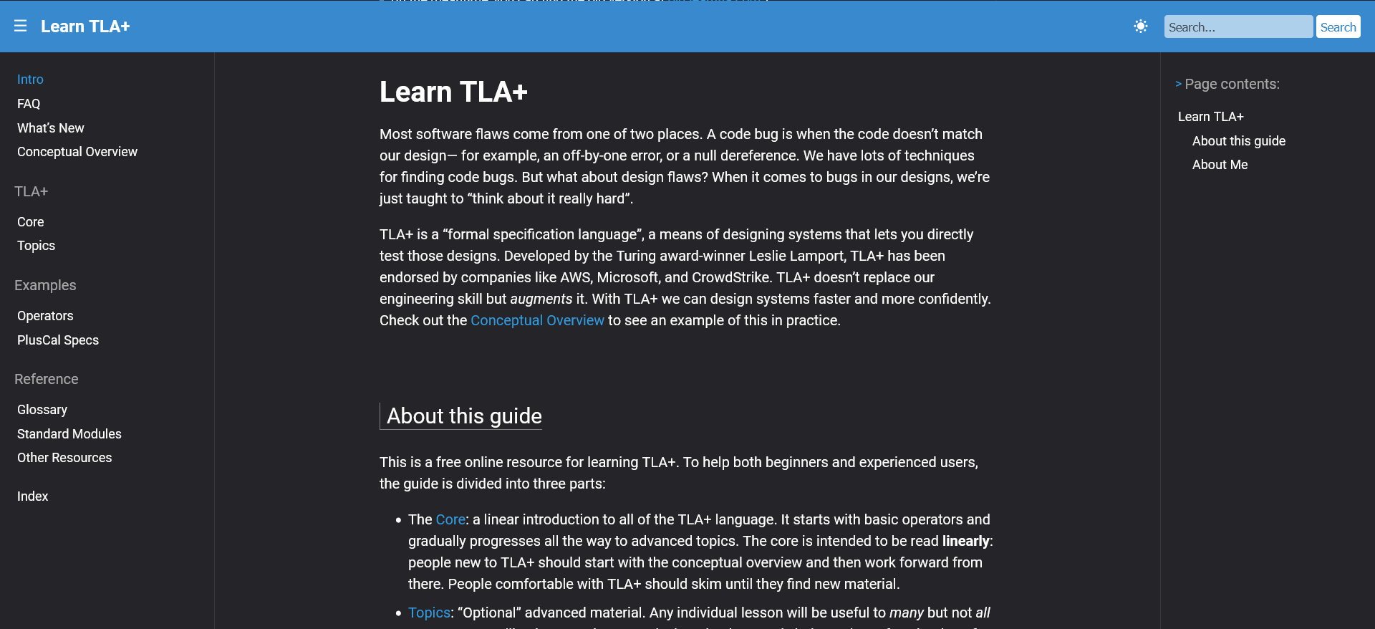
www.learntla.com
Or just hire me
Notes:
learntla.com, letsproveleftpad, I respect a lot of other specification languages, FS is a subset of FM, which includes proving code correct.

Slide 54
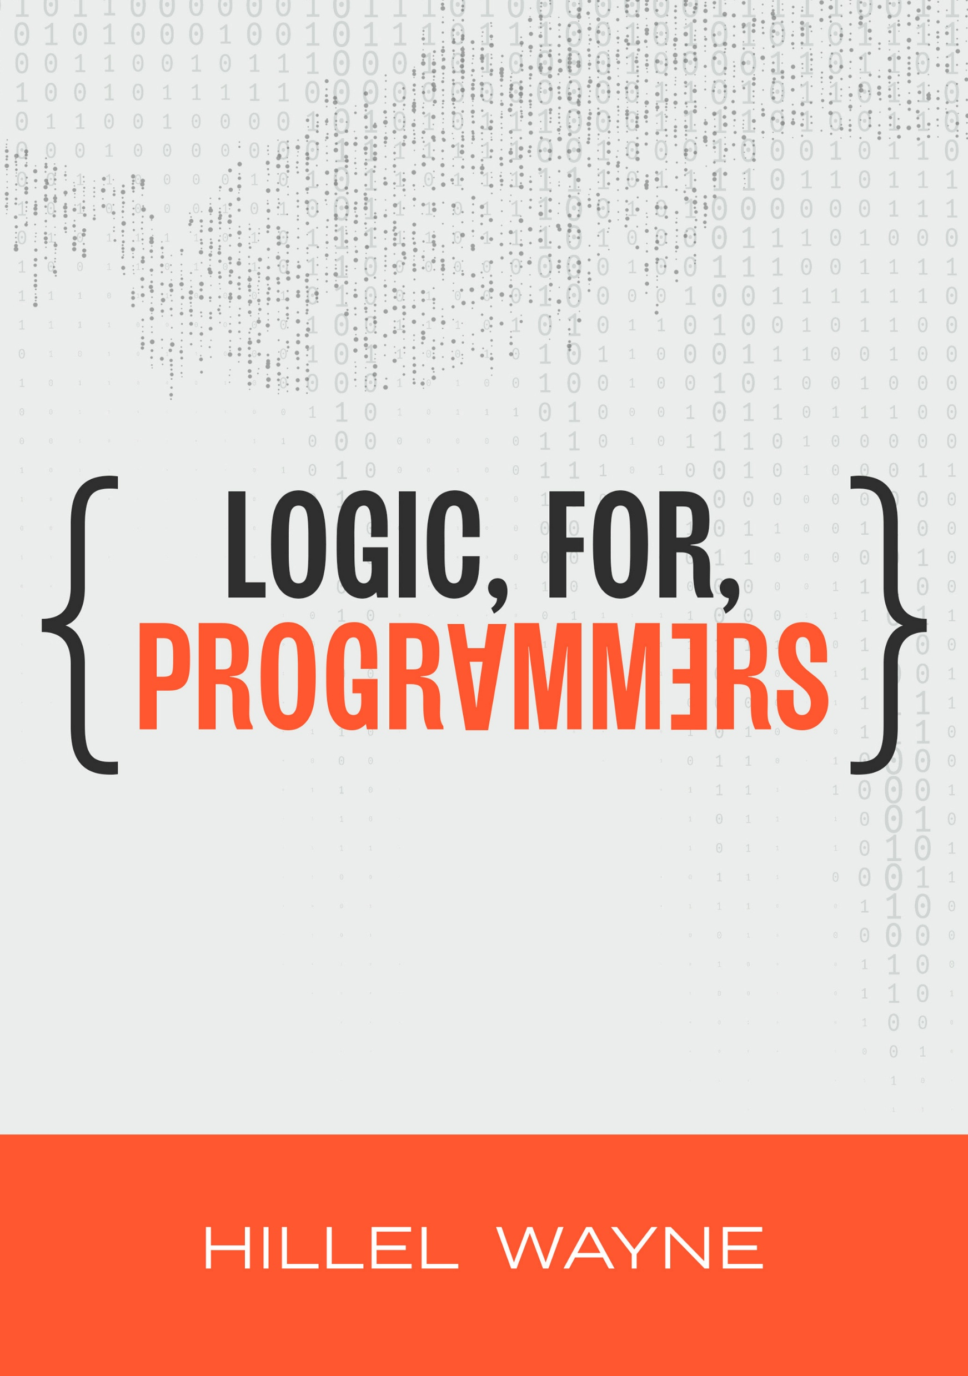
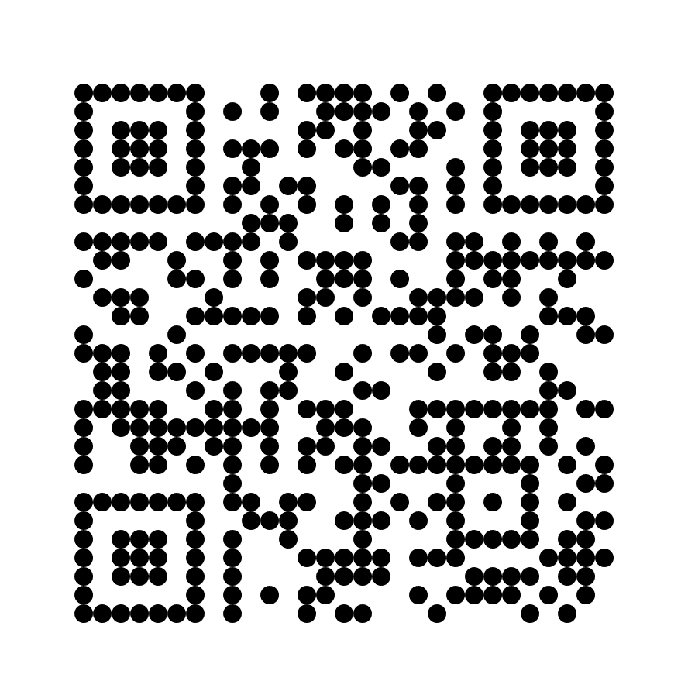
https://leanpub.com/logic
$10 off this week!
Notes:
https://leanpub.com/logic/c/systemsdistributed-3uLaQxE5ovf8

Slide 55
Thank you

