Slide 1
How to find bugs in systems that don't exist
Hillel Wayne
Notes:
SLOWER

Slide 2
do_thing (v 0.1)
check_if_thing_marked_done
mark_thing_as_done
actually_do_the_thing
Notes:
Error: mark thing done, then we fail

Slide 3
do_thing (v 0.1)
check_if_thing_marked_done
mark_thing_as_done
actually_do_the_thing || start_over
(Liveness)
Notes:
Error: mark thing done, then we fail

Slide 4
do_thing (v 0.2)
check_if_thing_marked_done
actually_do_the_thing || start_over
mark_thing_as_done
Notes:
We'll even harden it so that `actually_do_the_thing` never fails
New error. What if there are TWO thing doers
(You don't actually need two thing doers)
[[Maybe v0.3, do_thing_and_mark_as_done

Slide 5
do_thing (v 0.2)
check_if_thing_marked_done
actually_do_the_thing
mark_thing_as_done
Notes:
We'll even harden it so that `actually_do_the_thing` never fails
New error. What if there are TWO thing doers
(You don't actually need two thing doers)
[[Maybe v0.3, do_thing_and_mark_as_done

Slide 6
do_thing
do_thing
1
check_if_thing_marked_done
actually_do_the_thing
mark_thing_as_done
3
check_if_thing_marked_done
actually_do_the_thing
mark_thing_as_done
2
4
(Safety)
Notes:
New error. What if there are TWO thing doers

Slide 7
do_thing
send_package
check_if_thing_marked_done
actually_do_the_thing
mark_thing_as_done
check_if_package_sent
tell_warehouse_to_send_package
mark_package_as_sent
Notes:
New error. What if there are TWO thing doers

Slide 8
do_thing
feed_cat
check_if_thing_marked_done
actually_do_the_thing
mark_thing_as_done
check_if_cat_fed
add_food_to_bowl
mark_cat_as_fed
Notes:
New error. What if there are TWO thing doers

Slide 9
do_thing
install_app_on_device
check_if_thing_marked_done
actually_do_the_thing
mark_thing_as_done
check_if_app_installed
send_install_cmd_to_device
mark_as_installed
Notes:
Doesn't seem as bad except the case I'm thinking of this would randomly delete data

Slide 10
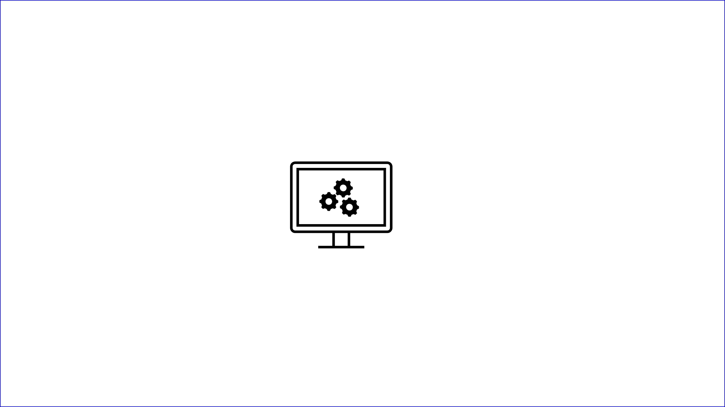

Slide 11
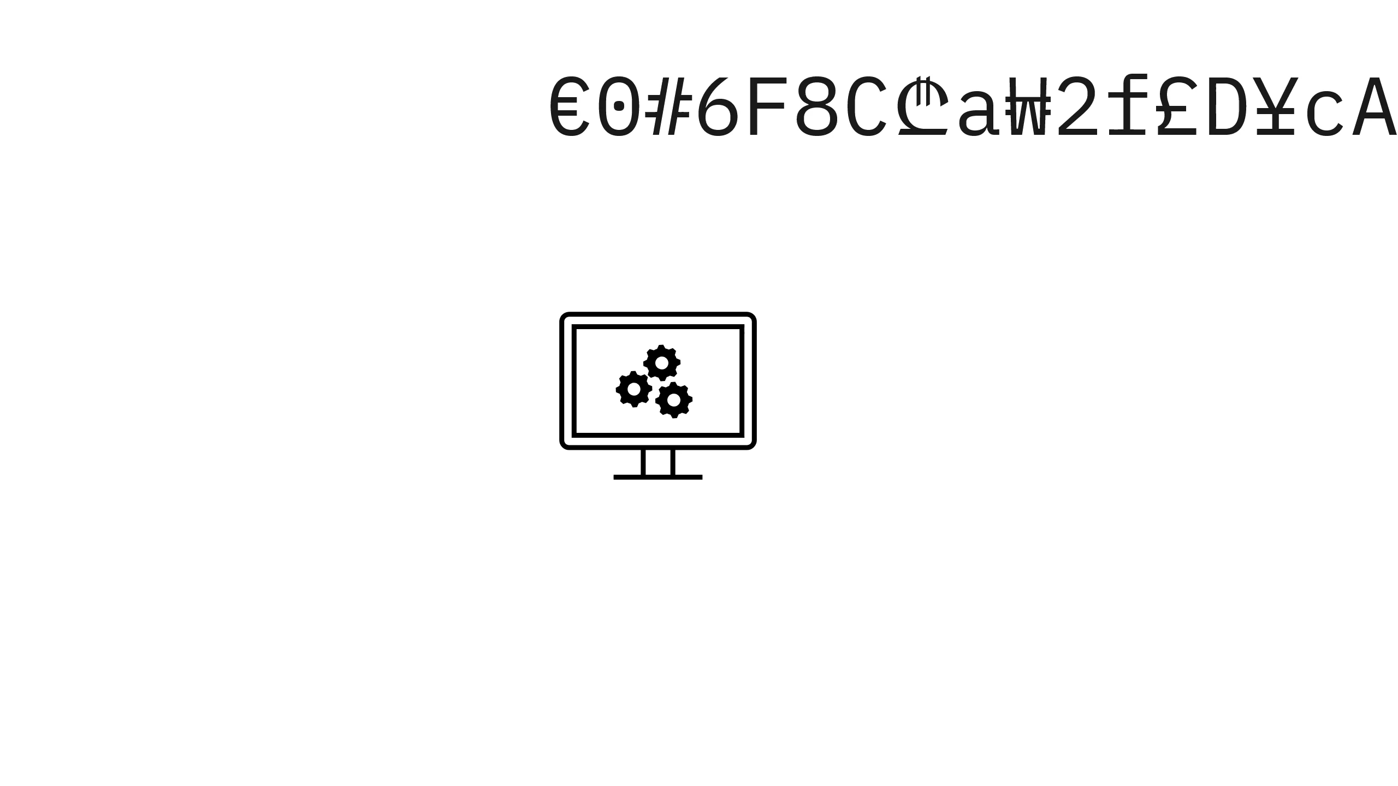

Slide 12
Formal methods
Tools and languages that do this
We are not covering them
We are covering the perspectives of formal methods
Notes:
We do this implicitly, Formal Specifications is about making how this is done explicit. It’ hard, so we’re not covering it, instead we cover the things that it helps teach us.

Slide 13
Topic Outline
Properties
Abstraction
Verification
Environment

Slide 14
Topic Outline
Properties: What it means for systems to be "correct“
Abstraction: How we simplify systems
Verification: How we can tell systems are correct
Environment: What assumptions make correctness possible
Notes:
This is stuff you already know

Slide 15
www.hillelwayne.com/talks/craft26

Slide 16
Properties

Slide 17
Property
Something that should be true of the system.
"No possible input crashes the program"
"One server handle 10,000 queries per second"
max :: List[Number] -> Number
assert max([1,2,3]) == 3
" We don't do the thing more than once" (safety)
" We do the thing at least once " (liveness)
Notes:
If not true, we have to change the system.
[Lead] We care about properties insofar as they are verifiable. Most are not verifiable. Some are.

Slide 18
2 QPS
10,000 QPS
10,000 QPS => 2 QPS
(implication)

Slide 19
Some properties are stronger than others.

Slide 20
P => Q
No memory errors => No use-after-free errors
Strong consistency => eventual consistency
GDPR compliance => cookie banners!

Slide 21
test user_login
test show_items
test add_item
"the user buys something with a coupon"
=>
test enter_checkout
test apply_coupon
test add_shipping
test complete_order

Slide 22
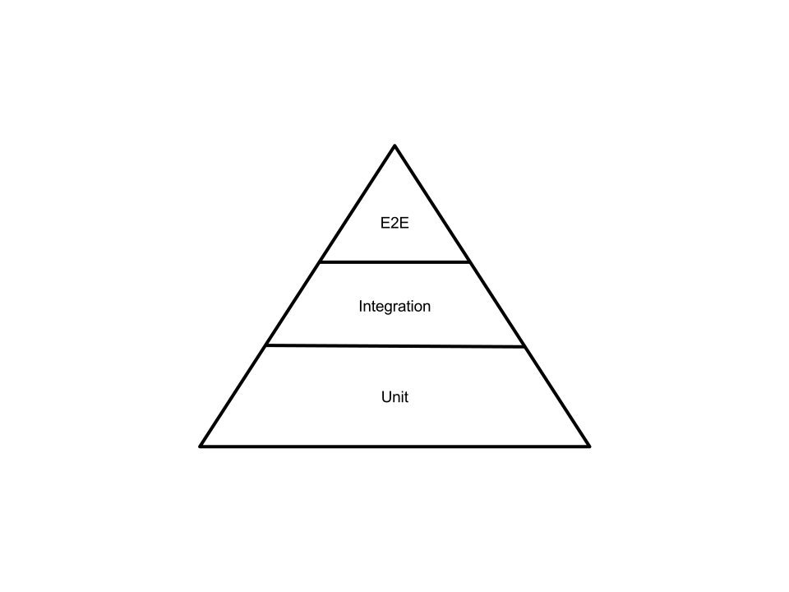

Slide 23
2 QPS
10,000 QPS
1
2
3
!(2 QPS) => !(10,000 QPS)
(contrapositive)

Slide 24
test user_login
test show_items
test add_item
"the user buys something with a coupon"
<=
test enter_checkout
test apply_coupon
test add_shipping
test complete_order
Notes:
[[Think about copy]]

Slide 25
Strong properties show that a system is correct.
Weak properties show why a system is incorrect.
Notes:
We see an emphasis on having more weak tests than strong tests in every testing culture
For example, Agile has the test pyramid
"No alarms" vs lots of alarms
[[This leads into the key idea of FM: an abstraction is weaker than an implementation]]

Slide 26
An abstraction is weaker than an implementation.
Notes:
This means we can find errors in abstractions, there are errors in the real system!
Abstraction is really rigorous in formal methods

Slide 27
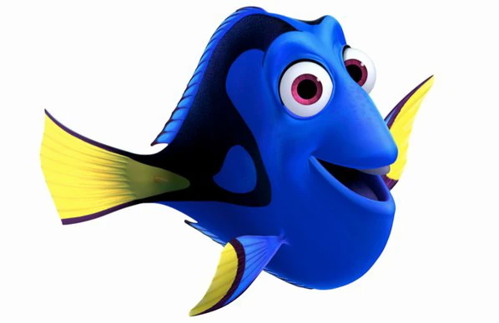
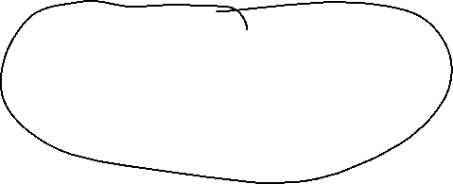
=>
Notes:
Formal methods is really good at getting us abstractions
[Full explanation, simplification, then implication]

Slide 28
Abstraction

Slide 29
Abstracting the thing doer
check_if_thing_marked_done
mark_thing_as_done
actually_do_the_thing || fail
check_if_thing_marked_done
actually_do_the_thing || fail
mark_thing_as_done
We don't do thing more than once
We do thing at least once
Notes:
As a recap, we are trying to simplify this system

Slide 30
Concept abstraction
send_package
do_thing
check_if_package_sent
tell_warehouse_to_send_package
mark_package_as_sent
check_if_thing_marked_done
actually_do_the_thing
mark_thing_as_done
Notes:
New error. What if there are TWO thing doers

Slide 31
Data abstraction
We don't do thing more than once
We do thing at least once
always (#done ≤ 1)
eventually (#done ≥ 1)
reality
implementation
abstraction
#done: Int
#done += 1
Notes:
What we are actually asking is that

Slide 32
Nondeterminism abstraction
int rand() {
global state
state = (state * 1103515245 + 12345) % 4294967296
return (state/65536) % 32768;
}
Notes:
1,103,515,245 % 2^32

Slide 33
Nondeterminism abstraction
How implementations fail
How abstractions fail
Package missing
Mechanism jammed
No file permissions
File lock
Not enough space
Network Interrupt
do_thing || start_over
Notes:
* If these failures matter we could CHOOSE to add them.

Slide 34
Verification

Slide 35
Verifying the thing doer
check_if_thing_marked_done
mark_thing_as_done
actually_do_the_thing || start_over
check_if_thing_marked_done
actually_do_the_thing || start_over
mark_thing_as_done
#done: Int
marked: {marked, unmarked}
step: 1-3 + done
always (#done ≤ 1)
eventually (#done ≥ 1)
Notes:
[lead] Specification tooling has different ways of checking these properties against these sytems, we're going to hand implement the simplest one, brute force model checking

Slide 36
check_if_thing_marked_done
mark_thing_as_done
actually_do_the_thing || start_over
always (#done ≤ 1)
eventually (#done ≥ 1)
step 1
unmarked
#done: 0
step 2
unmarked
0
step 3
marked
0
done
marked
1
step 1
marked
0
done
marked
0
step 1
marked
1
Notes:
Mention state space, path
[Don't care why fail]
Then mention safety property (next slide is new text)

Slide 37
check_if_thing_marked_done
mark_thing_as_done
actually_do_the_thing || start_over
always (#done ≤ 1)
eventually (#done ≥ 1)
step 1
unmarked
#done: 0
step 2
unmarked
0
step 3
marked
0
done
marked
1
step 1
marked
0
done
marked
0
step 1
marked
1
Notes:
Mention state space, path
[Don't care why fail]
Then mention safety property (next slide is new text)

Slide 38
check_if_thing_marked_done
mark_thing_as_done
actually_do_the_thing || start_over
always (#done ≤ 1)
eventually (#done ≥ 1)
step 1
unmarked
#done: 0
step 2
unmarked
0
step 3
marked
0
done
marked
1
step 1
marked
0
done
marked
0
step 1
marked
1
Notes:
Liveness property fails
COUNTEREXAMPLE?

Slide 39
check_if_thing_marked_done
actually_do_the_thing || start_over
mark_thing_as_done
always (#done ≤ 1)
eventually (#done ≥ 1)
step 1
unmarked
#done: 0
step 2
unmarked
0
step 3
marked
0
done
marked
1
step 1
marked
0
done
marked
0
step 1
marked
1
Notes:
Liveness property fails
COUNTEREXAMPLE?

Slide 40
check_if_thing_marked_done
actually_do_the_thing || start_over
mark_thing_as_done
always (#done ≤ 1)
eventually (#done ≥ 1)
step 1
unmarked
#done: 0
step 2
unmarked
0
step 3
unmarked
1
done
marked
1
step 1
marked
1

Slide 41
2x
check_if_thing_marked_done
actually_do_the_thing
mark_thing_as_done
always (#done ≤ 1)
eventually (#done ≥ 1)
step 1
step 1
unmarked
#done: 0
step 1
step 2
unmarked
0
step 1
step 3
unmarked
1
step 1
done
marked
1
step 2
step 1
unmarked
0
step 2
step 2
unmarked
0
step 2
step 3
unmarked
1
step 3
step 3
unmarked
2
Notes:
How do we represent concurrency?
Local State & global state

Slide 42
Notes:
x

Slide 43


Slide 44
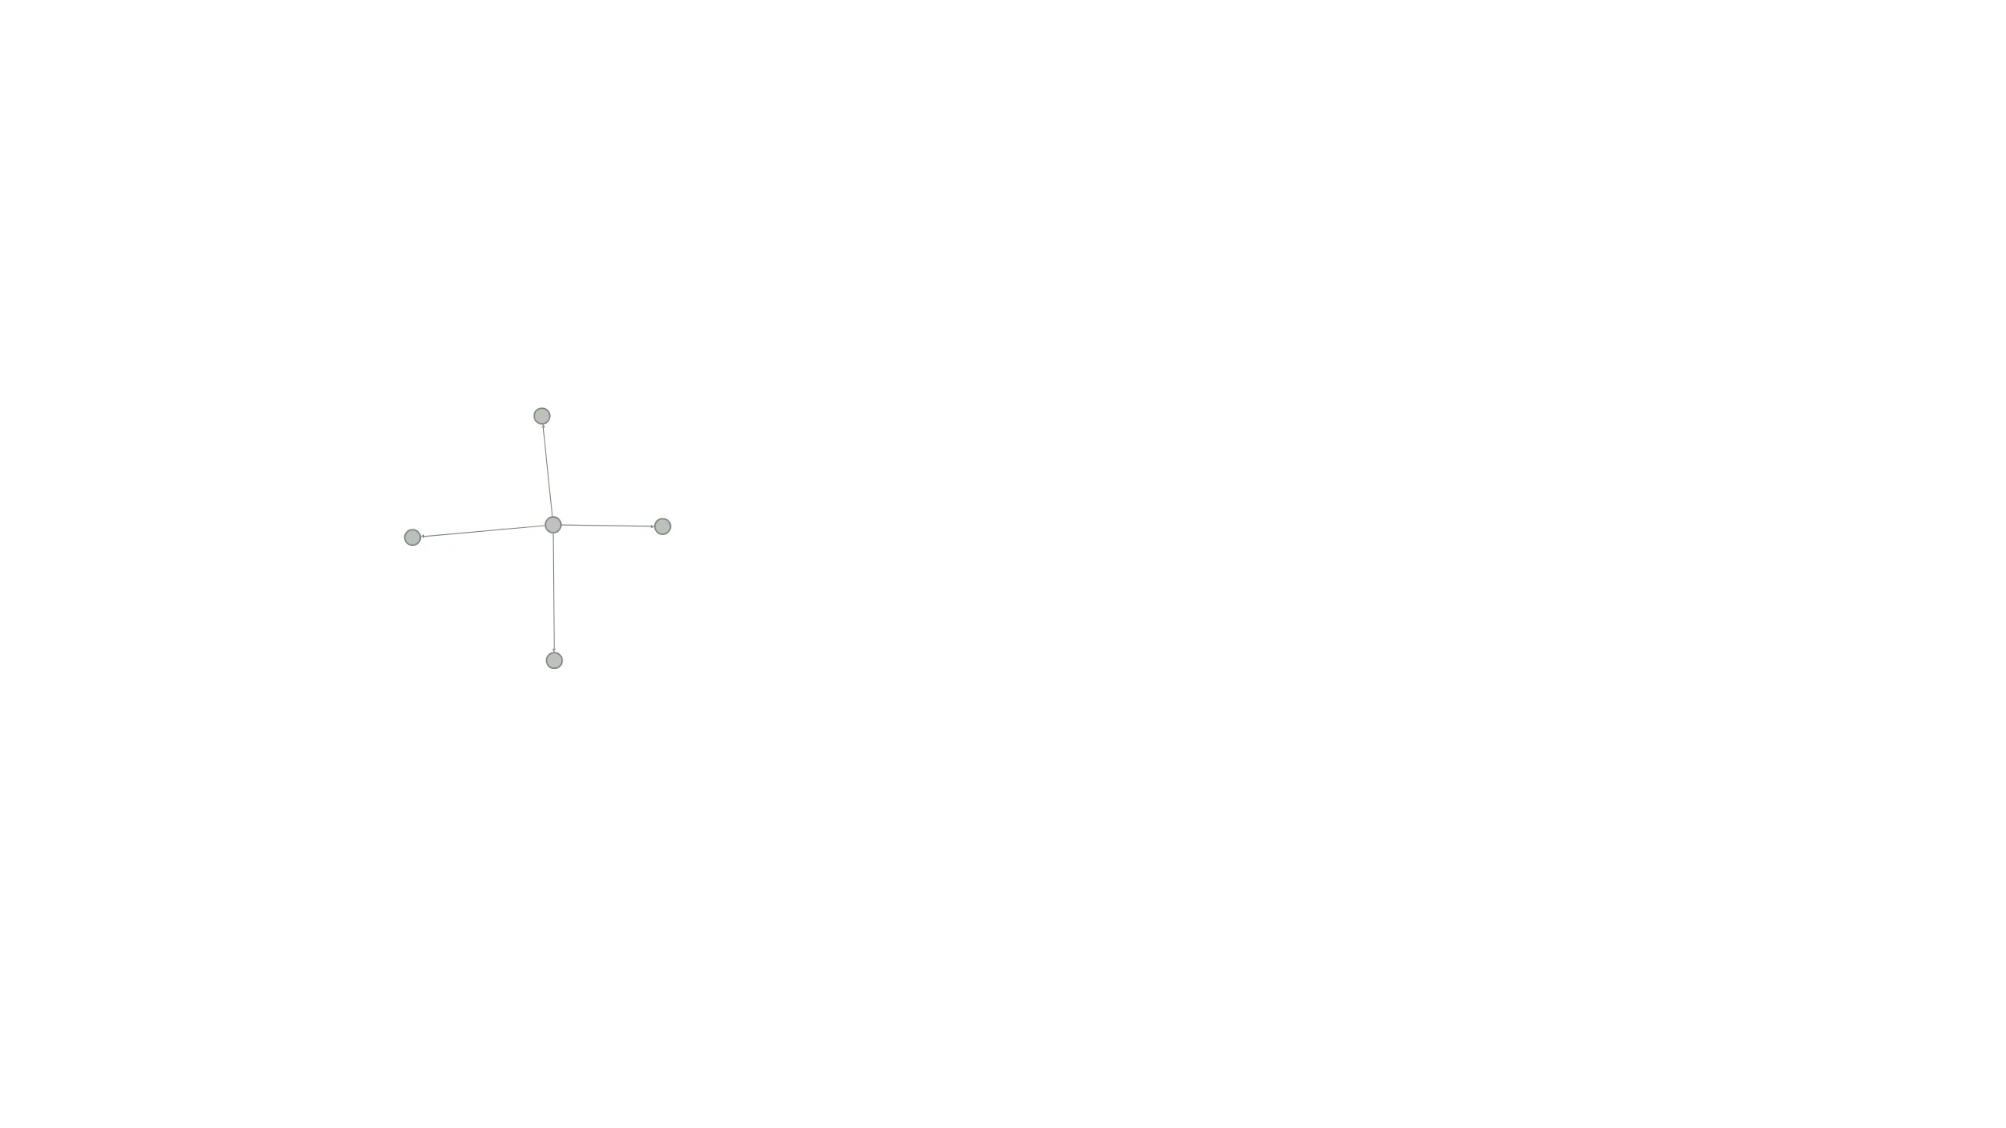
Notes:
Possible for states to go back to old ones

Slide 45
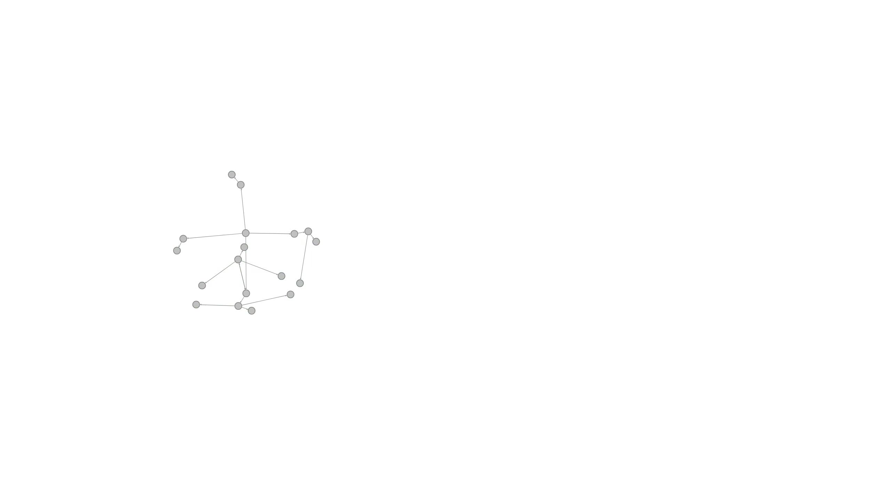

Slide 46
Adversarial Nondeterminism
x = rand(1, 1000)
y = rand(1, 1000)
z = rand(1, 1000)
if x + y + z == 3:
erase_hard_drive()
1
1
1
Notes:
Can this erase your hard drive?

Slide 47
check_if_thing_marked_done
actually_do_the_thing || start_over
mark_thing_as_done
always (#done ≤ 1)
eventually (#done ≥ 1)
step 1
unmarked
0
step 2
unmarked
0
step 3
unmarked
1
done
marked
1
step 1
marked
1

Slide 48
check_if_thing_marked_done
actually_do_the_thing || fail
mark_thing_as_done
done and go back to 1
always (#done ≤ 1)
eventually (#done ≥ 1)
step 1
unmarked
0
step 2
unmarked
0
step 3
unmarked
1
done
marked
1
step 2
unmarked
1
step 3
unmarked
2
step 1
marked
1
Notes:
fairness (moved to later)

Slide 49
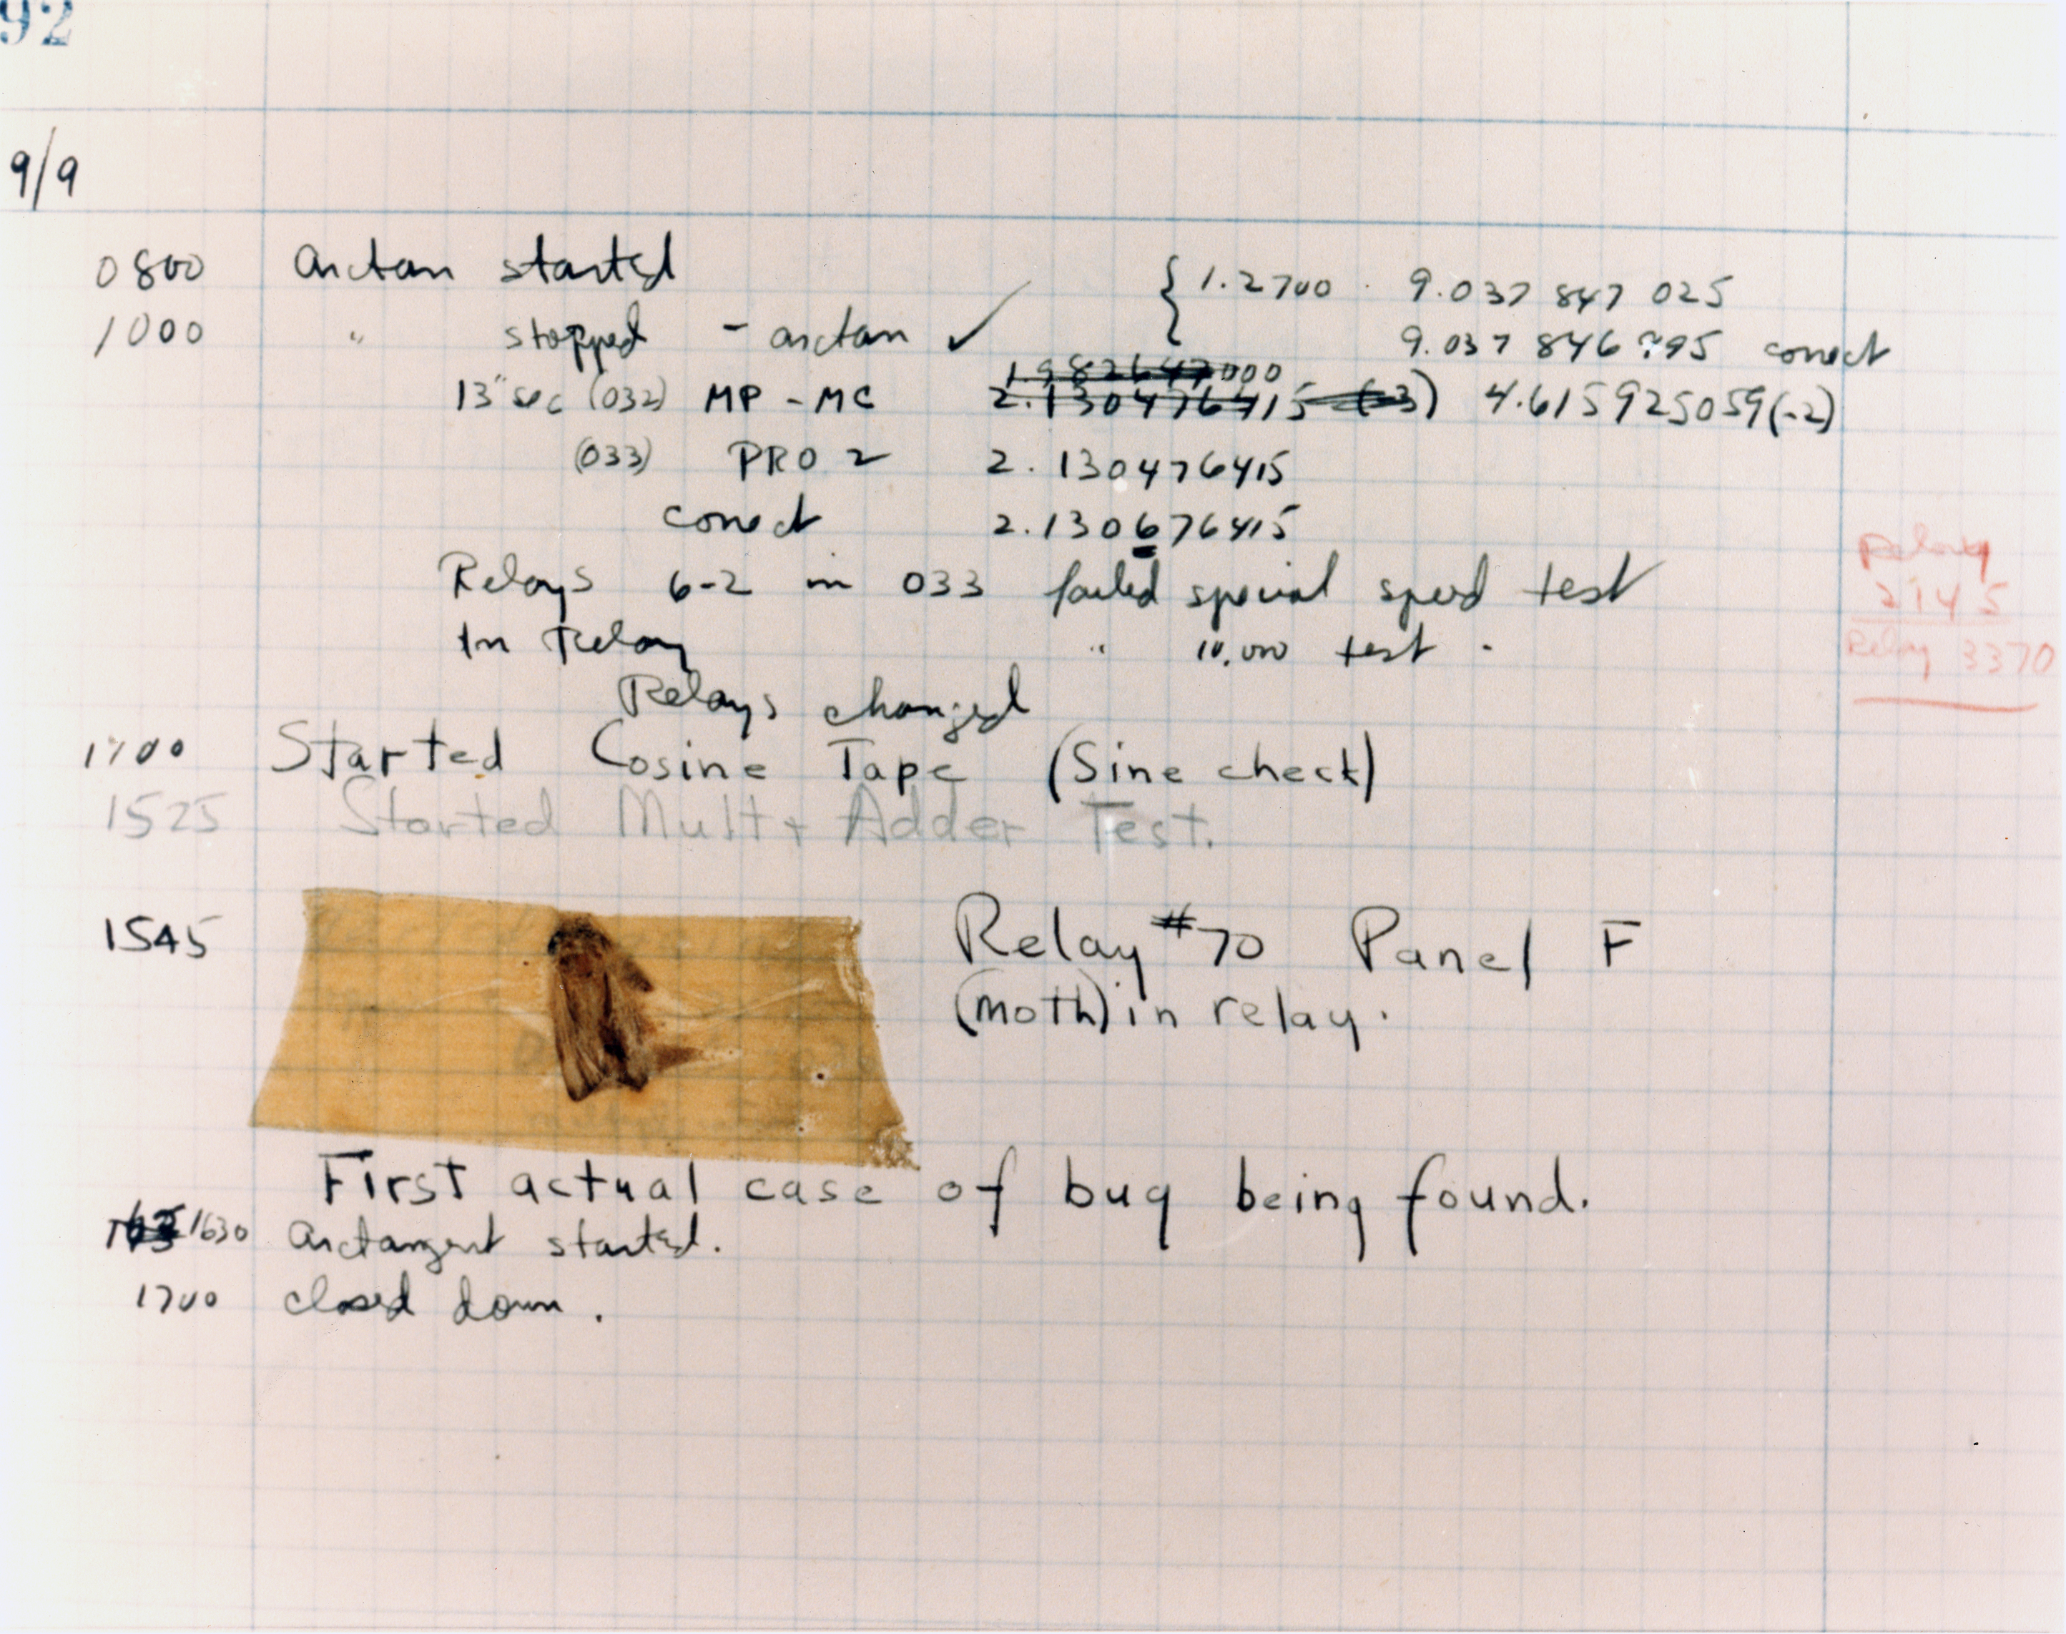

Notes:
https://upload.wikimedia.org/wikipedia/commons/e/e7/First_Computer_Bug%2C_1947.jpg

Slide 50
Environment
Notes:
Importance of understanding the environment

Slide 51
Assumption: what must be true for our system to work.
Notes:
FM really seriously treats the subject of assumptions
In the interest of time, I can give you heuristics.

Slide 52
int maxof(int x, int y) {
if (x < y) { return y;}
return x;
}
Notes:
Does this work? Yes, assuming
Compiler doesn’t have a bug
CPU instruction set doesn’t have a bug
Hardware doesn’t have a problem
Steady power
No cosmic rays

Slide 53
Properties of Assumptions
1. Assumptions are outside our control

Slide 54
always (#done ≤ 1)
eventually (#done ≥ 1)
V.1
#thing_doers ≤ 1
do_thing never fails
(check; mark; do)
V.2
#thing_doers ≤ 1
do_thing doesn’t fail infinitely
(check; do; mark)
Notes:
Possible alternate for the assumptions

Slide 55
eventually (#done ≥ 1)
V.1
do_thing never fails
(check; mark; do)
is stricter than
V.2
do_thing doesn’t fail infinitely
(check; do; mark)
Notes:
Kinda like how some properties are stronger than others, some assumptions are stricter than others.
(This actually is formed with implication, too)
v1 needs stricter assumptions for liveness

Slide 56
Properties of Assumptions
Assumptions are outside our control
Some assumptions are stricter than others

Slide 57
eventually (#done ≥ 1)
V.1
do_thing never fails
(check; mark; do)
is stricter than
V.2
do_thing doesn’t fail infinitely
(check; do; mark)
Notes:
Kinda like how some properties are stronger than others, some assumptions are stricter than others.
(This actually is formed with implication, too)
v1 needs stricter assumptions for liveness

Slide 58
always (#done ≤ 1)
eventually (#done ≥ 1)
V.1
#thing_doers ≤ 1
do_thing never fails
(check; mark; do)
V.2
#thing_doers ≤ 1
do_thing doesn’t fail infinitely
(check; do; mark)
Notes:
morph into property assumptions

Slide 59
always (#done ≤ 1)
always (#done ≤ 6)
eventually (#done ≥ 1)
V.1
#thing_doers ≤ 1
#thing_doers ≤ 6
do_thing never fails
(check; mark; do)
V.2
#thing_doers ≤ 1
#thing_doers ≤ 6
do_thing doesn’t fail infinitely
(check; do; mark)
Notes:
Possible alternate for the assumptions

Slide 60
always (#done ≤ 1)
=>
always (#done ≤ 6)
V.1
(check; mark; do)
#thing_doers ≤ 1
is stricter than
#thing_doers ≤ 6
V.2
(check; do; mark)
Notes:
Possible alternate for the assumptions

Slide 61
Properties of Assumptions
Assumptions are outside our control
Some assumptions are stricter than others
A given design with stricter assumptions has stronger properties.
Loosening an environment weakens a system’s properties.

Slide 62
always (#done ≤ 1)
=>
always (#done ≤ 6)
V.1
(check; mark; do)
#thing_doers ≤ 1
is stricter than
#thing_doers ≤ 6
V.2
(check; do; mark)
Notes:
Possible alternate for the assumptions

Slide 63
always (#done ≤ 1)
always (#done ≤ 6)
eventually (#done ≥ 1)
V.1
#thing_doers ≤ 1
#thing_doers ≤ 6
do_thing never fails
(check; mark; do)
V.2
#thing_doers ≤ 1
#thing_doers ≤ 6
do_thing doesn’t fail infinitely
(check; do; mark)
Notes:
Possible alternate for the assumptions

Slide 64
always (#done ≤ 1)
eventually (#done ≥ 1)
V.1
#thing_doers ≤ 1
do_thing never fails
(check; mark; do)
V.2
#thing_doers ≤ 1
do_thing doesn’t fail infinitely
(check; do; mark)
Notes:
morph into property assumptions

Slide 65
always (#done ≤ 1)
eventually (#done ≥ 1)
V.1
#thing_doers ≤ 1
do_thing never fails
(check; mark; do)
V.2
#thing_doers ≤ 1
do_thing doesn’t fail infinitely
(check; do; mark)
V.3
(check && mark; do)
no assumptions
do_thing never fails
Notes:
Possible alternate for the assumptions

Slide 66
always (#done ≤ 1)
eventually (#done ≥ 1)
V.1
(check; mark; do)
#thing_doers ≤ 1
do_thing never fails
V.3
is stricter than
=
(check && mark; do)
no assumptions
do_thing never fails
Notes:
V.1.5 is now better in safety, but still worse in liveness. “Best engineering judgement” / “tradeoffs” / etc.
A stronger system design can get the same properties with fewer assumptions.

Slide 67
Properties of Assumptions
Assumptions are outside our control
Some assumptions are stricter than others
A given design with stricter assumptions has stronger properties.
Loosening an environment weakens a system’s properties.
Loose assumptions can be compensated by system design.

Slide 68
always (#done ≤ 1)
eventually (#done ≥ 1)
V.1
(check; mark; do)
#thing_doers ≤ 1
do_thing never fails
V.3
is stricter than
=
(check && mark; do)
no assumptions
do_thing never fails
V.2
is looser than
is stricter than
#thing_doers ≤ 1
do_thing doesn’t fail infinitely
(check; do; mark)
Notes:
V.1.5 is now better in safety, but still worse in liveness. “Best engineering judgement” / “tradeoffs” / etc.
A stronger system design can get the same properties with fewer assumptions.

Slide 69
Properties of Assumptions
Assumptions are outside our control
Some assumptions are stricter than others
A given design with stricter assumptions has stronger properties.
Loosening an environment weakens a system’s properties.
Loose assumptions can be compensated by system design.
Different systems need different assumptions for the same properties.

Slide 70
Summary
Systems have assumptions and properties.
Weaker properties localize bugs faster than strong properties
We can study abstractions to find bugs in implementations
Knowing assumptions is critical to correctness

Slide 71
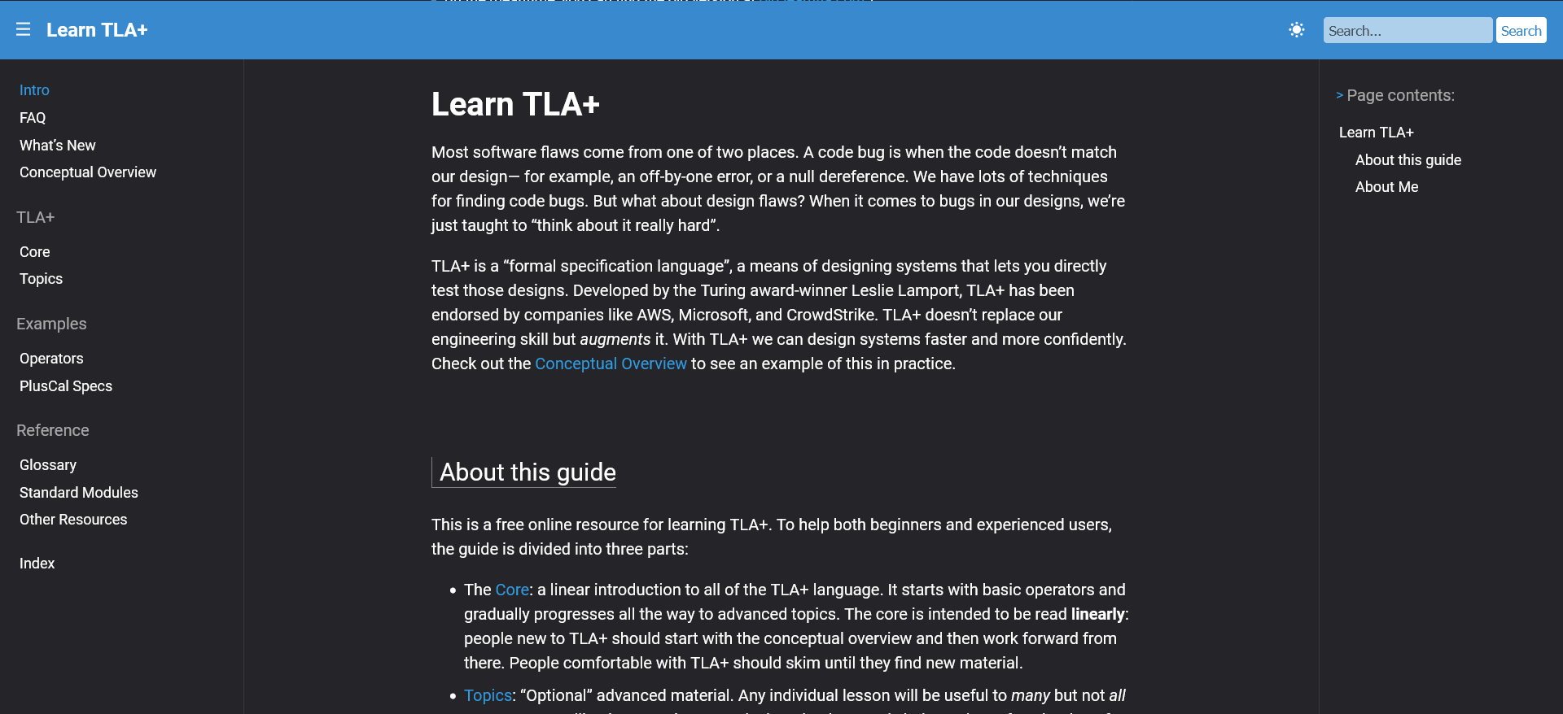
www.learntla.com
Notes:
learntla.com, letsproveleftpad, I respect a lot of other specification languages, FS is a subset of FM, which includes proving code correct.

Slide 72
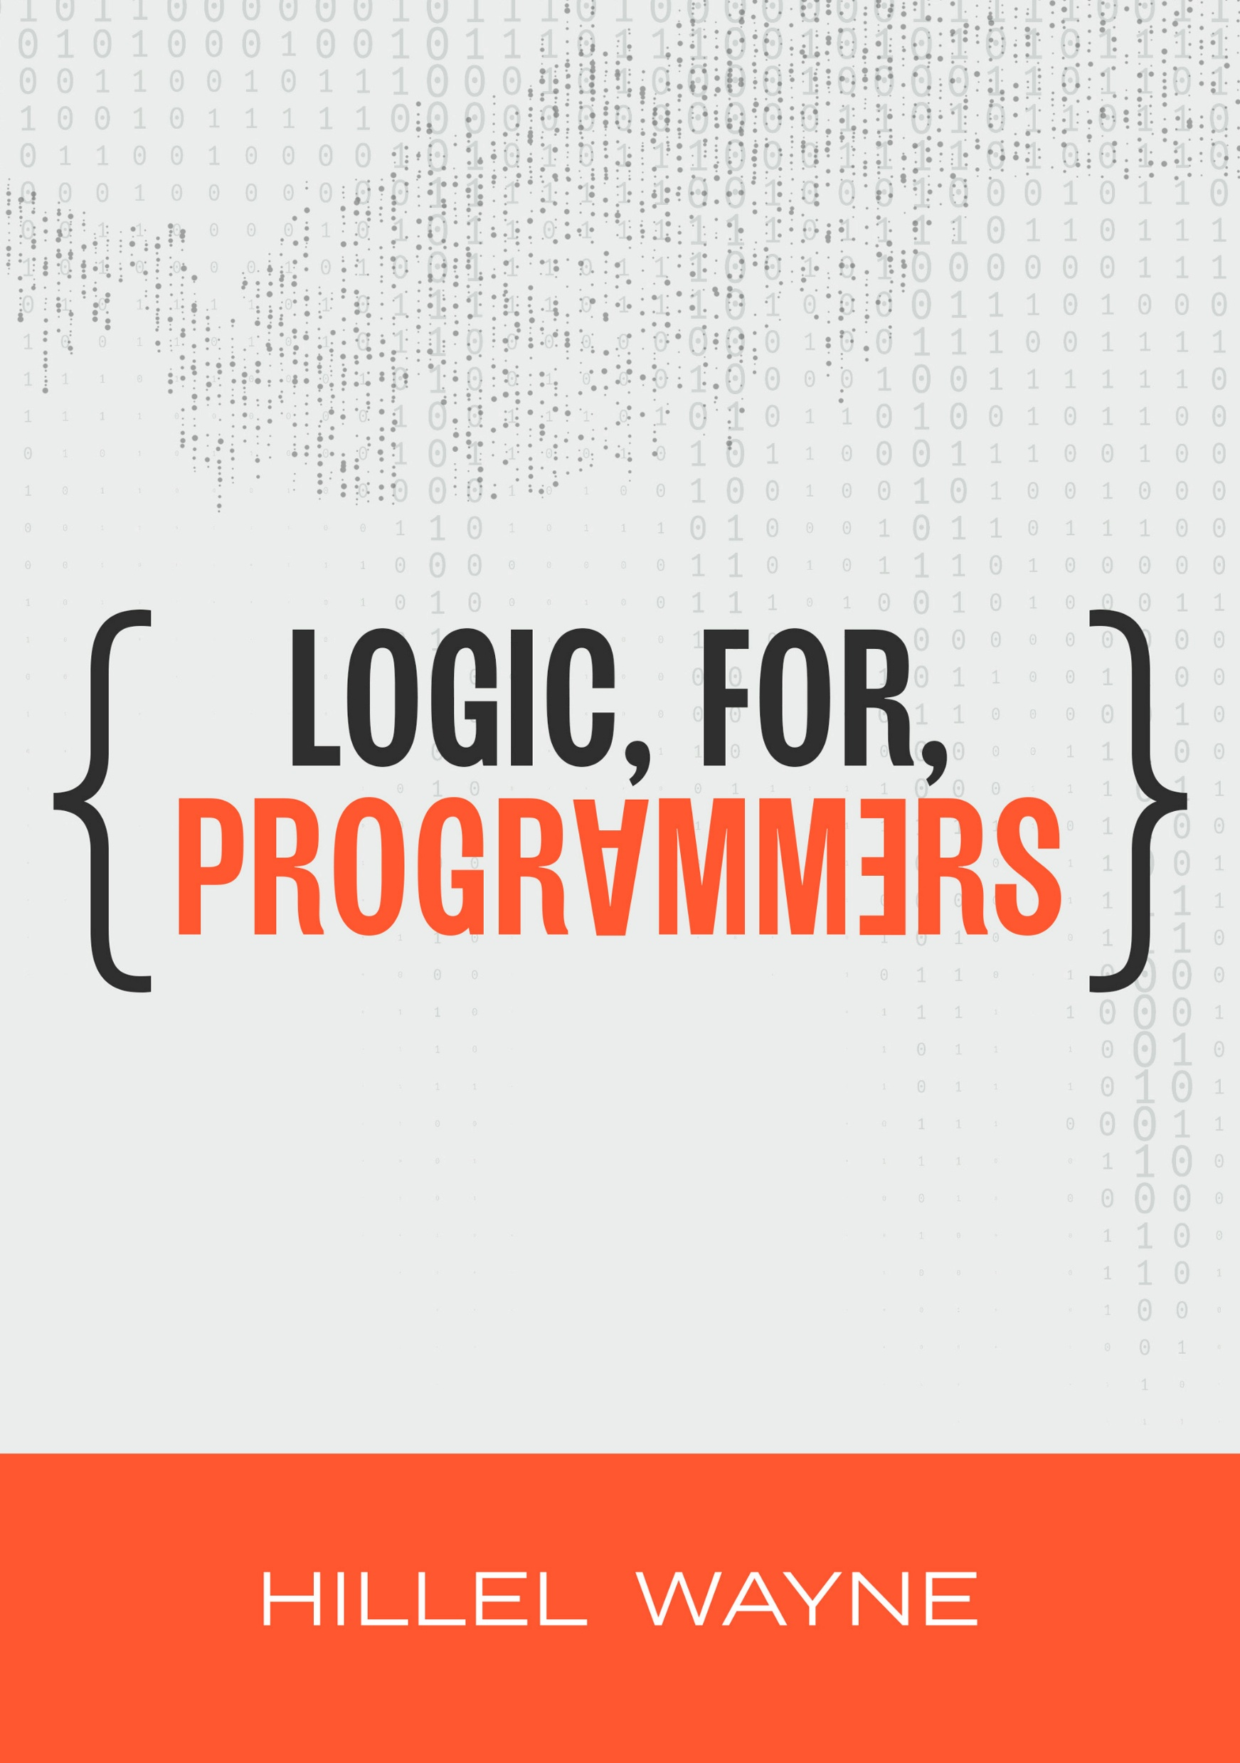
https://leanpub.com/logic
$10 off this week!
Notes:
https://leanpub.com/logic/c/systemsdistributed-3uLaQxE5ovf8

Slide 73
Thank you

